Slide 1






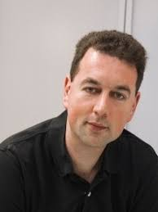
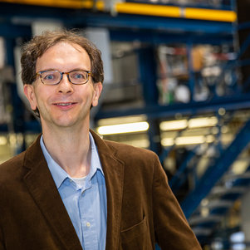
Molecular simulation for predicting the thermophysical properties of fluids (Applicative session)
Darshan Raju, TU Delft, D.Raju@tudelft.nl
Dr. ir. Mahinder Ramdin, TU Delft, M.Ramdin@tudelft.nl
Prof. Dr. Sofia Calero, TU Eindhoven, s.calero@tue.nl
Dr. David Dubbeldam, UvA, D.Dubbeldam@uva.nl
Prof. dr. ir. Thijs Vlugt, TU Delft, T.J.H.Vlugt@tudelft.nl
Politecnico di Milano, Piacenza, Italy
26/06/2025

Slide 2
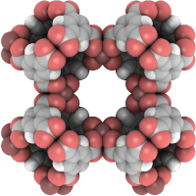
Molecular Simulations with RASPA2/3
RASPA2/3^{1,2,3} is a molecular simulation package developed at the University of Amsterdam (Amsterdam, The Netherlands) during 2022/2025 in active collaboration with Eindhoven University of Technology (Eindhoven, Netherlands), Delft University of Technology (Delft, The Netherlands), and Northwestern University (Evanston, USA).
RASPA2/3 is a popular open-source software package used to compute thermodynamic and transport properties in bulk phases and porous media.
RASPA2/3 Documentation: https://iraspa.org/raspa/
RASPA2/3
Dubbeldam, D.; Torres-Knoop, A.; Walton, K. S. On the Inner Workings of Monte Carlo Codes. Mol. Simul. 2013, 39 (14–15), 1253–1292. https://doi.org/10.1080/08927022.2013.800299.
Dubbeldam, D.; Calero, S.; Ellis, D. E.; Snurr, R. Q. RASPA: Molecular Simulation Software for Adsorption and Diffusion in Flexible Nanoporous Materials. Mol. Simul. 2016, 42 (2), 81–101. https://doi.org/10.1080/08927022.2015.1010082.
Y.A. Ran, S. Sharma, S.R.G. Balestra, Z. Li, S. Calero, T.J.H. Vlugt, R.Q. Snurr, D. Dubbeldam, J. Chem. Phys., 161, 114106 (2024). https://doi.org/10.1063/5.0226249
2

Slide 3

Installing Anaconda or Miniconda
To install and use RASPA3 via Conda, participants need to have a system with:
64-bits architecture
4 GB of main memory (or more)
Python (installed via Anaconda or Miniconda)
The system can be Windows 10/11 or MacOS or Linux.
Anaconda or Miniconda can be downloaded from anaconda website for Windows 10/11, MacOS, and Linux: https://www.anaconda.com/download/success
Double click the downloaded installer from the Downloads folder to launch Anaconda installer

Slide 4
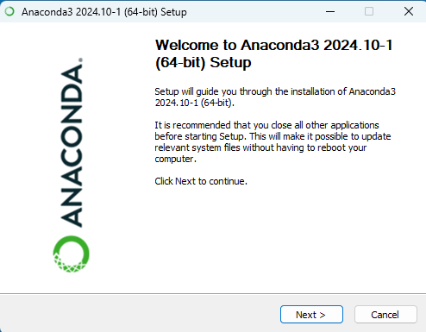
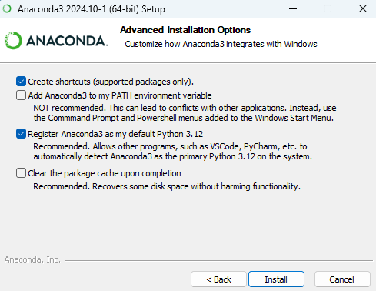
Installing Anaconda or Miniconda
To install Anaconda:
Anaconda installer dialogue box for windows will look like the snapshot to the right.
Click Next > and agree to the Anaconda’s Terms of Service.
Select Just Me (Recommended) to install Anaconda for the current user account.
Keep the default installation location and click Next > .
It is not recommended to add Anaconda to the system PATH environmental variable.
Click Next > once the installation is completed and deselect the launch navigator and getting started with Anaconda distribution options and click Finish .

Slide 5
Installing RASPA3 for Molecular Simulations
Windows 10/11: Open Anaconda Prompt (or Command Prompt if conda is added to PATH)
Linux/macOS: Use the default terminal
To install RASPA3 via conda:
Create a Conda environment called raspa_env
To activate raspa_env Conda environment
To verify installation
conda install –n raspa_env –c conda-forge::raspa3
bash
conda activate raspa_env
bash
raspa3
bash
5

Slide 6

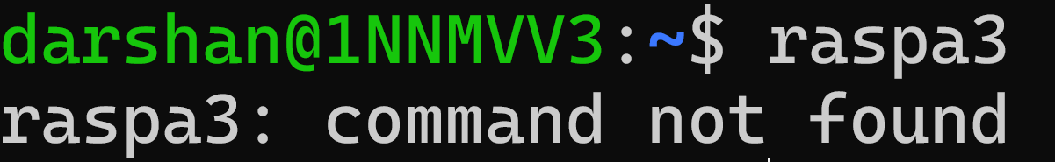

Installing RASPA3 for Molecular Simulations
To verify installation
If the terminal returns: File ‘simulation.json’ not found, then RASPA3 is installed correctly
If the terminal returns: ‘raspa3: command not found’, then RASPA3 is not installed
raspa3
bash
6

Slide 7
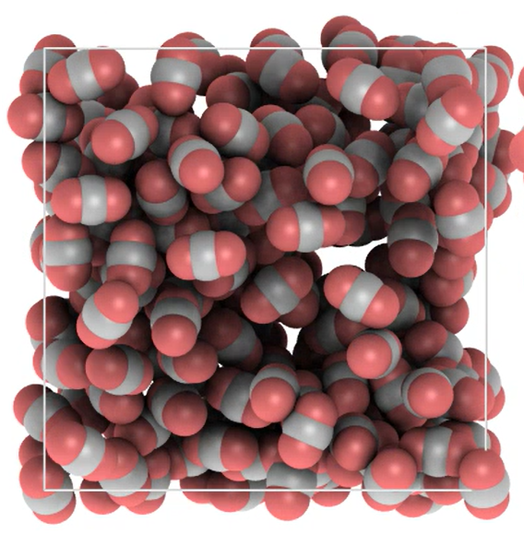
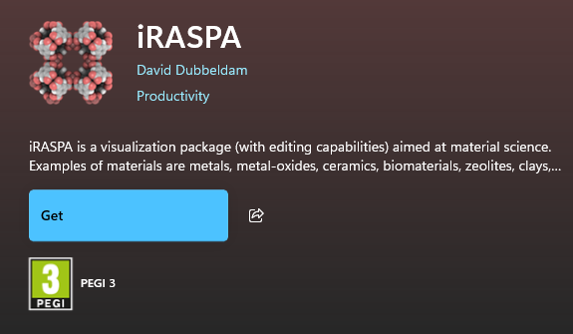
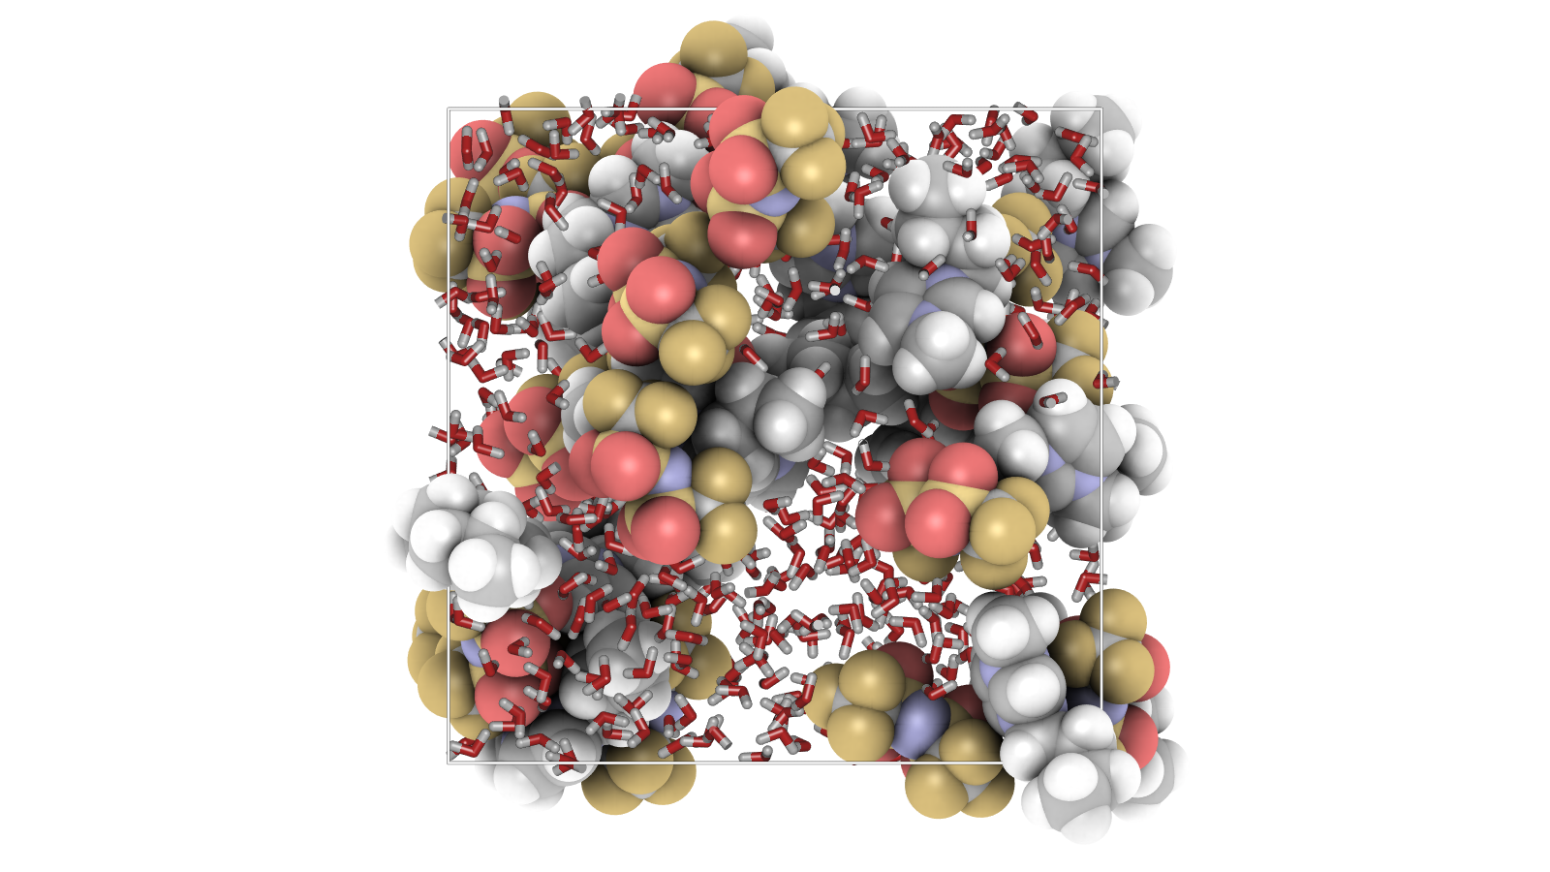
Installing iRASPA: Molecular Simulation Visualizer
Windows 10/11: Download iRAPSA from Windows store
macOS: Download iRAPSA from app store
Linux: Open terminal and run,
sudo snap install iraspa
bash
7

Slide 8
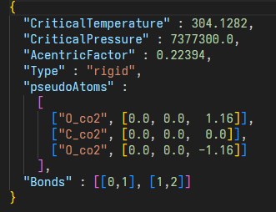

Exercise - 1
Monte Carlo simulation of CO₂ in a box to compute density
We will perform Monte Carlo (MC) simulations of 250 carbon dioxide (CO₂) molecules confined in a cubic simulation box of initial dimensions 30 × 30 × 30 Å.
The goal is to compute the density of the system as a function of pressure at a constant temperature.
For that we need the molecule file (CO2.json) and the interaction model of CO₂ which we call it as forcefield (force_field.json).
180°
O
C
O
Snapshot of CO2.json file
8

Slide 9
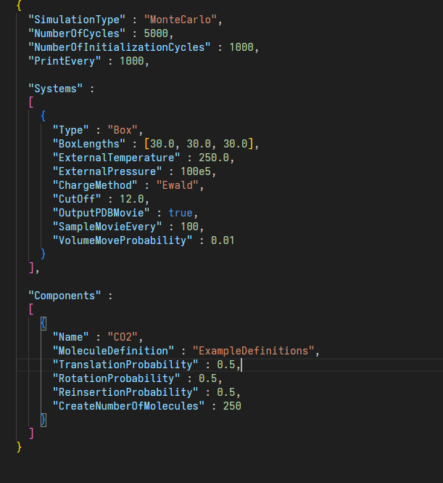
Exercise - 1
After 1000 cycles of initialization, production run is performed to sample density. For every 100 cycle the configuration is written and appended to the .pdb file in the movies folder. The results of the simulations are stored in the output folder.
The simulation results are printed every 1000 MC cycles
The temperature and pressure are given here
Snapshot of simulation.json file
9

Slide 10
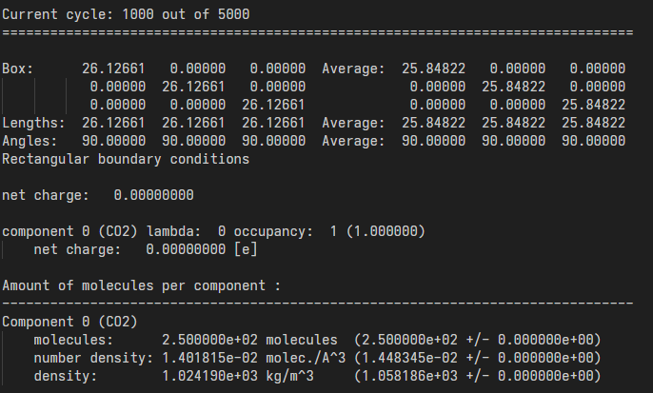
Exercise - 1
To run the simulation:
raspa3 simulation.json &
bash
While the simulations are running the simulation output for every 1000 MC cycles are printed in the *.txt file in the output folder.
Snapshot of output text file
10

Slide 11
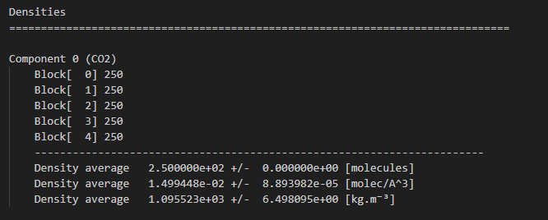
Exercise - 1
After the simulation is completed, average densities sampled during the production run are printed at the end of the *.txt file in the output folder.
Ensemble averaged density computed from MC simulation at 250 K and 200 bar is 1095.5 ± 6.5 kg/m³
Snapshot of output text file at T = 250 K and P = 200 bar from a completed simulation
11

Slide 12
Exercise - 1
Densities obtained from MC simulations can be compared with the densities calculated from the Span and Wagner equation of state at a temperature and pressure using REFPROP.
Pressure [bar] | Density [kg/m3]
40 | 1055.01
60 | 1062.58
80 | 1069.70
100 | 1076.42
120 | 1082.79
140 | 1088.84
160 | 1094.62
180 | 1100.16
200 | 1105.47
Ensemble averaged density at 250 K and 200 bar obtained from Monte Carlo simulations is 1095.5 ± 6.5 kg/m³.
At the same conditions, the density calculated using the equation of state is 1105.47 kg/m³.
The density obtained from MC simulations deviates by less than 1% from the reference
Densities of CO₂ at 250 K computed using the Span and Wagner equation of state.
12

Slide 13
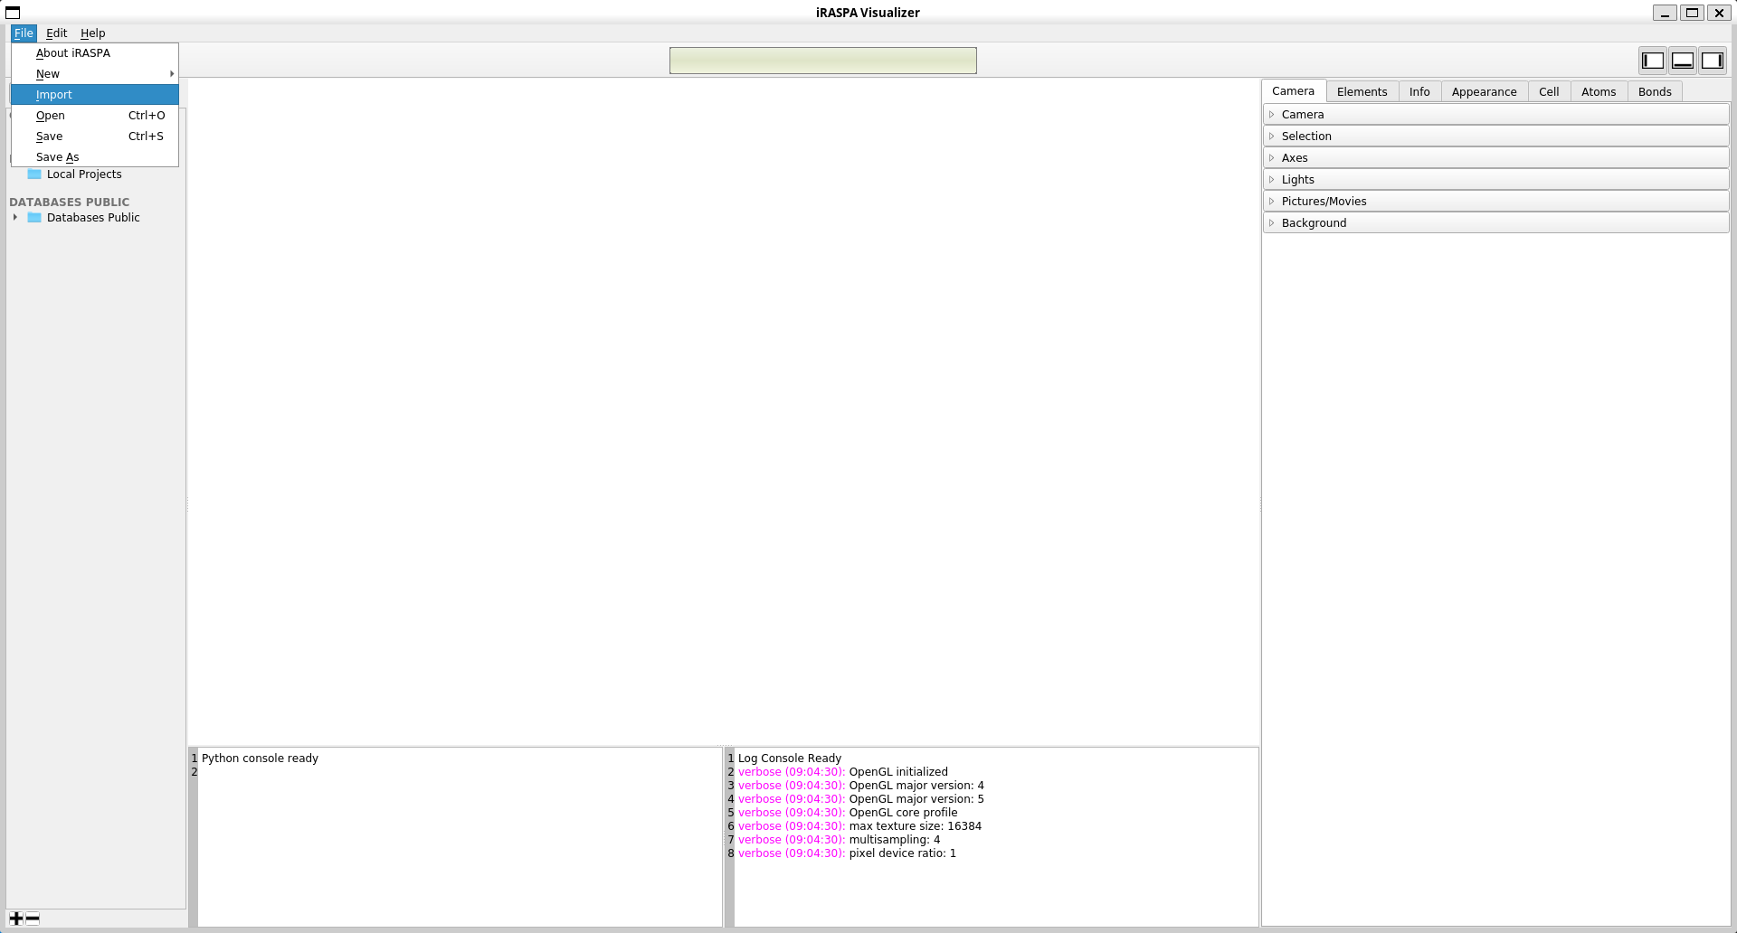
Exercise - 1
To visualize configurations of molecules in the simulation box the .pdb file in the movies folder is imported to iRASPA:
Import the .pdb file
Detail view
Project view
13

Slide 14
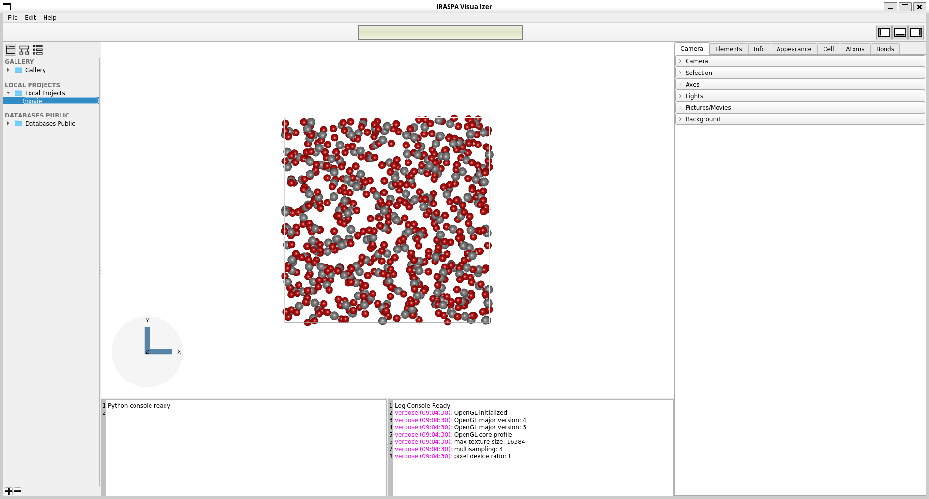
Exercise - 1
After importing the file, select the imported file in the project view
Selecting the imported file
14

Slide 15
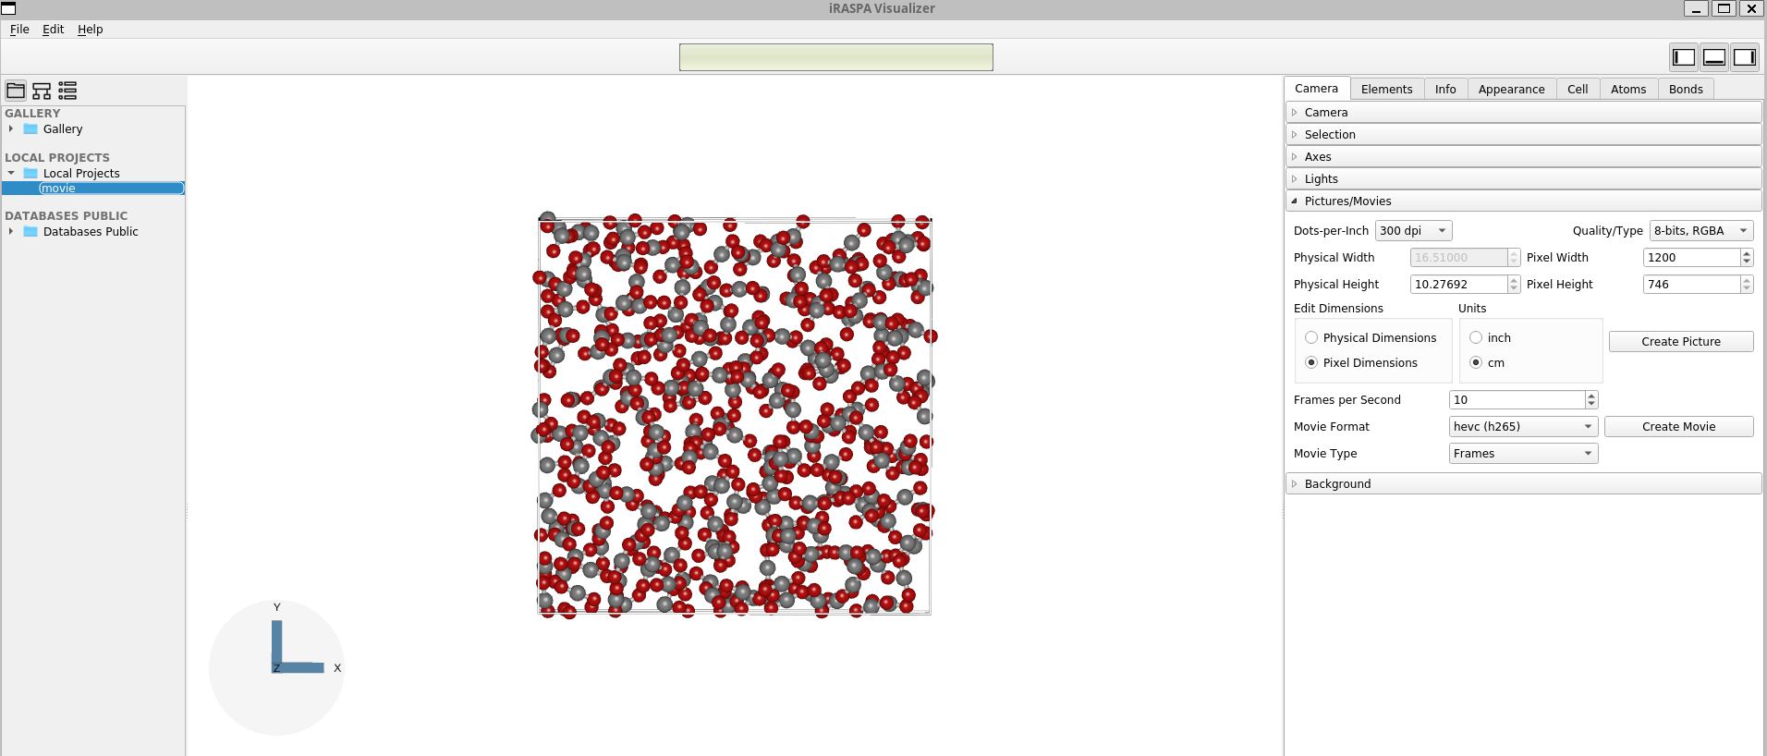
Exercise - 1
After importing the file, select the imported file in the project view
To create a movie out of all configurations
Change the Movie Type to Frames and click create movie to save the video file
15

Slide 16
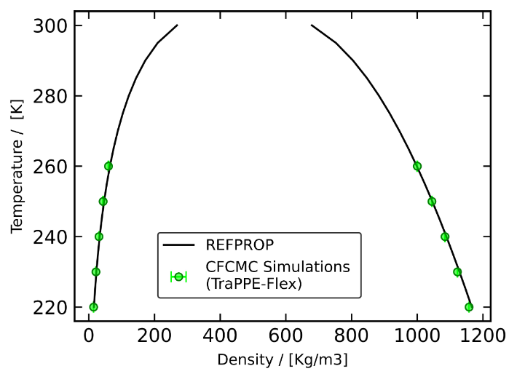
Exercise - 2
Vapor Liquid Equilibria (VLE) of CO₂
To compute the VLE densities of CO₂ at a given temperature, MC simulation in Gibbs Ensemble (GE) will be performed.
Two simulation boxes will be used, one for the liquid phase and one for the gas phase to sample the densities.
MC moves are performed to swap CO₂ molecules between the boxes.
The given target temperature should be within 220 to 280 Kelvin.
Green points in the plot represent example target temperatures, for which corresponding liquid and gas temperatures will be obtained from GE simulations.
VLE densities of CO₂ as a function of temperature computed using the Span and Wagner equation of state.
16

Slide 17
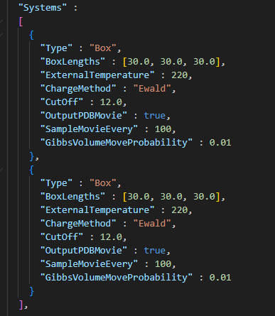
Exercise - 2
Same molecule file (CO2.json) and forcefield file (force_field.json) used in exercise 1 will also be used in this exercise to compute VLE.
The simulation.json file differs from the previous exercise. In this exercise we need two simulation boxes (two systems) to enable Gibbs ensemble simulation.
Box - 1
Box - 2
Snapshot of simulation.json file
17

Slide 18
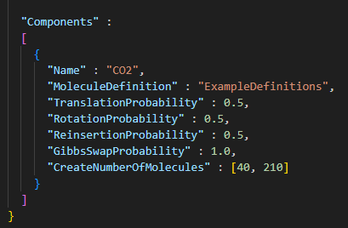
Exercise - 2
To promote phase separation, the initial configuration assigns a lower number of molecules to one of the simulation boxes, designated as the vapor phase, while the other box is initialized with a higher molecular count to represent the liquid phase.
Gibbs ensemble simulations uses molecule exchange trial moves which enables molecular transfers between the two simulation boxes, allowing for the equilibration across phases.
Particle exchange trial moves
Box – 1 (40 CO₂ molecules)
Box – 1 (210 CO₂ molecules)
Snapshot of simulation.json file
Run the simulation:
raspa3 simulation.json &
bash
18

Slide 19
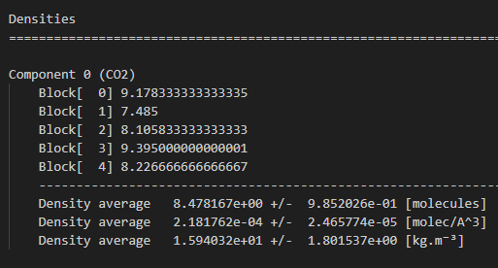
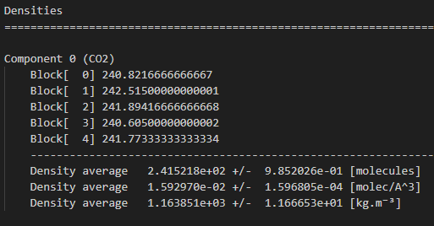
Exercise - 2
After the simulation is completed, average densities sampled during the production run are printed at the end of the *.s0.txt and *.s1.txt files in the output folder for two different systems.
Snapshot of *.s0.txt file at T = 220 K bar from a completed simulation
Snapshot of *.s1.txt file at T = 220 K bar from a completed simulation
Ensemble averaged vapor density computed from MC simulation at 220 K is 15.94 ± 1.8 kg/m³
Ensemble averaged liquid density computed from MC simulation at 220 K is 1163.85 ± 11.66 kg/m³
19

Slide 20
Exercise - 2
VLE densities and saturation pressures obtained from MC simulations can be compared to the values calculated from the Span and Wagner equation of state at a temperature and pressure using REFPROP.
Ensemble averaged vapor and liquid densities at 220 K obtained from MC simulation are 1163.85 ± 11.66 kg/m³ and 15.94 ± 1.8 kg/m³.
At the same conditions, vapor and liquid densities at 220 K calculated using the equation of state are 1166.13 kg/m³ and 15.81 kg/m³.
The saturation pressure at 220 K computed from MC simulation is 6.01 bar, closely matching the value (5.99 bar) calculated from the Span–Wagner equation of state.
Temperature [Kelvin] | Vapor densities [kg/m³] | Liquid densities [kg/m³] | Saturation pressure [bar]
220 | 15.81 | 1166.13 | 5.99
230 | 23.27 | 1128.68 | 8.92
240 | 33.29 | 1088.86 | 12.82
250 | 46.64 | 1045.97 | 17.85
260 | 64.41 | 998.88 | 24.18
270 | 88.37 | 945.82 | 32.03
280 | 121.74 | 883.58 | 41.60
VLE densities and saturation pressures of CO₂ as a function of temperature computed using the Span and Wagner equation of state.
20

Slide 21
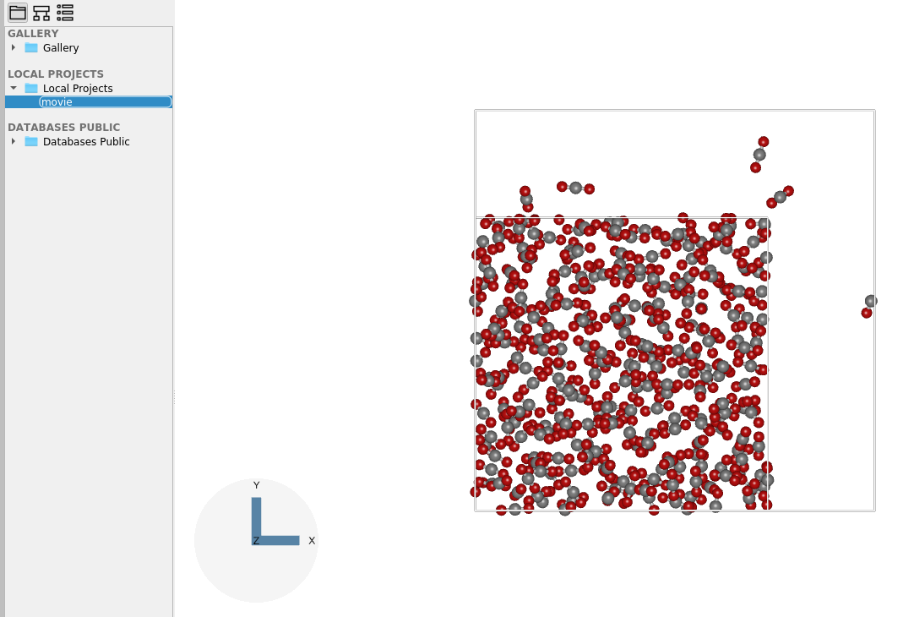
Exercise - 2
To visualize configurations of molecules in two simulation boxes import pdb files of both the system combined (as single project file) into iRASPA:
We have two simulation boxes on top of each other.
We need to pan one simulation box to further left or right
21

Slide 22
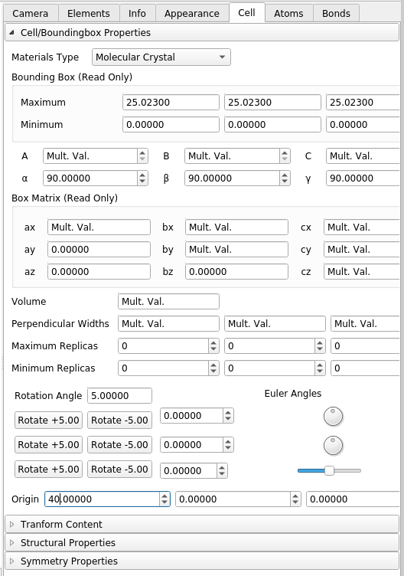
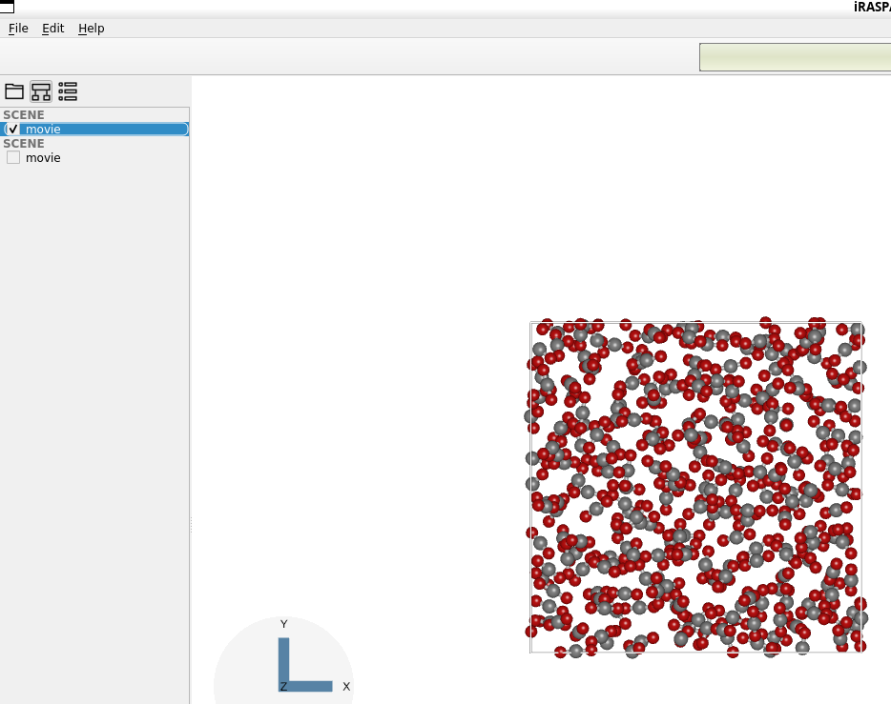
Exercise - 2
To shift the liquid simulation box to left:
Deselect the vapor box in the pipe
Shift the origin (located in cell tab) to 40 A toward the x-axis
22

Slide 23
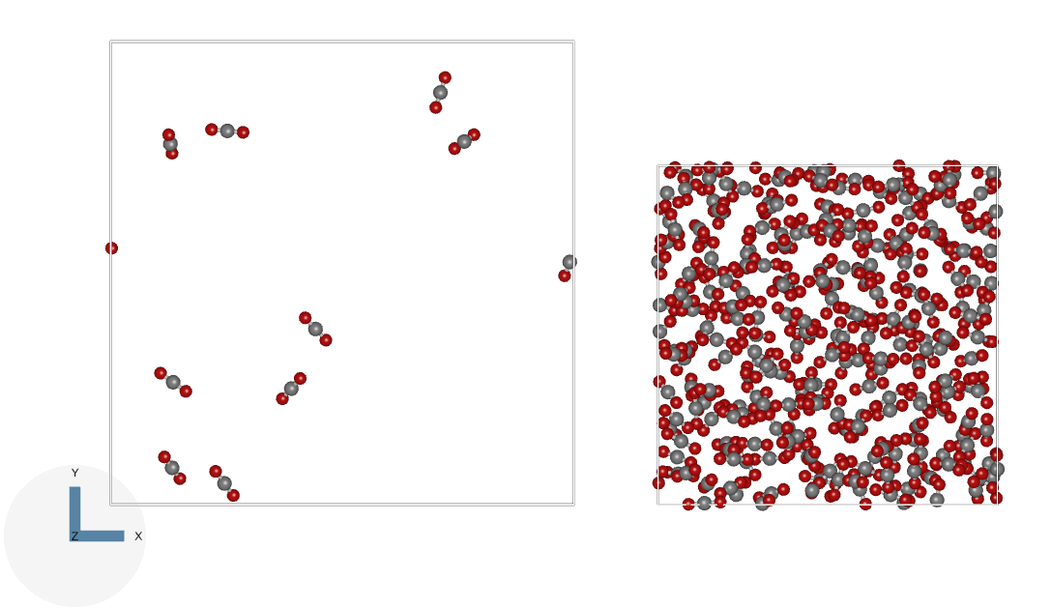
Exercise - 2
After shifting the liquid box, select the vapor box again in the project view to create a movie.
To create a movie out of all configurations
Change the Movie Type to Frames and click create movie to save the video file
23

Slide 24
Simulation validation for multiple state points with different cutoff radius and molecules for both exercises
24

Slide 25
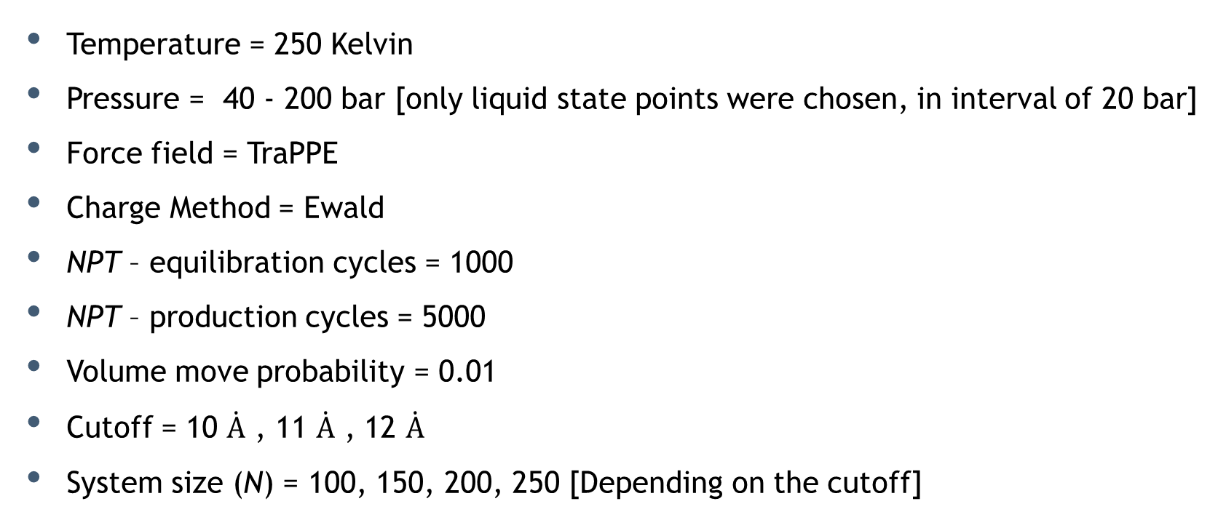
Exercise - 1
Monte Carlo of CO₂ in a box in NPT ensemble to compute density
Temperature = 250 Kelvin
Pressure = 40 - 200 bar [only liquid state points were chosen, in interval of 20 bar]
Force field = TraPPE
Charge Method = Ewald
NPT – equilibration cycles = 1000
NPT – production cycles = 5000
Volume move probability = 0.01
Cutoff = 10 $\dot{A}$ , 11 $\dot{A}$ , 12 $\dot{A}$
System size (N) = 100, 150, 200, 250 [Depending on the cutoff]
The simulation time on my PC was recorded, and deviations from REFPROP results were analyzed
25

Slide 26
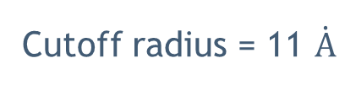
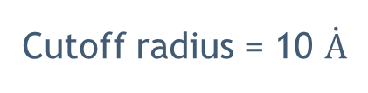
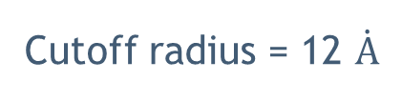
Exercise - 1
Monte Carlo of CO₂ in a box
T = 250 Kelvin; P = 40 - 200 bar
Cutoff radius = 10 $\dot{A}$
Cutoff radius = 11 $\dot{A}$
Cutoff radius = 12 $\dot{A}$
N = 200
N = 250
N = 150
N = 200
N = 250
N = 250
For the given cut off radius, the minimum number of particles was chosen such that the box length remained well above twice the cutoff radius
26

Slide 27
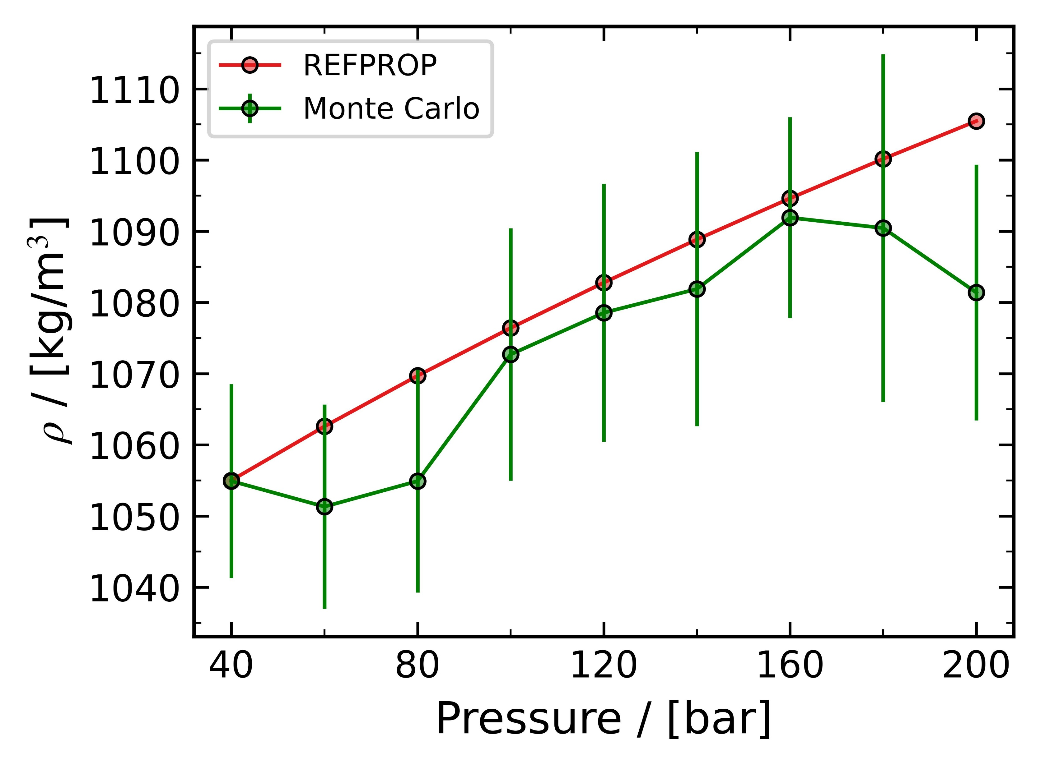
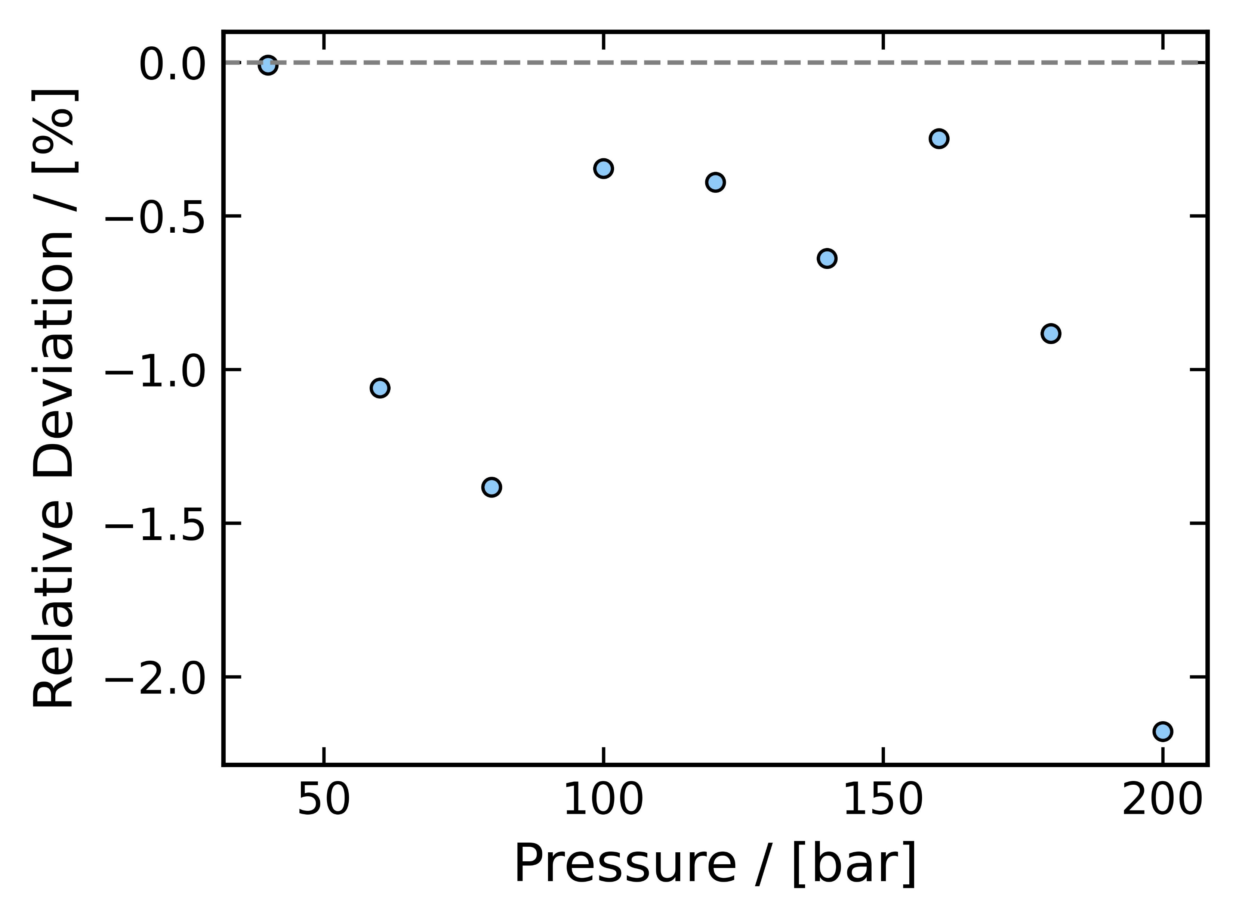
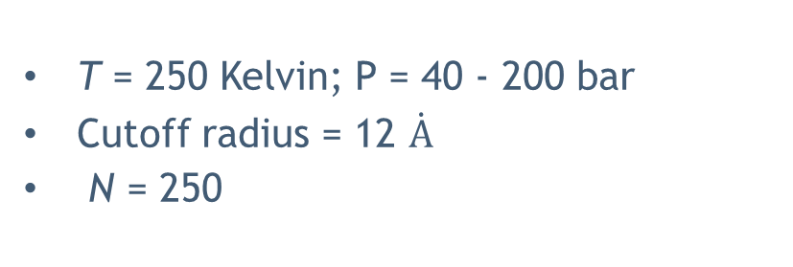
Exercise - 1
T = 250 Kelvin; P = 40 - 200 bar
Cutoff radius = 12 $\dot{A}$
N = 250
Simulation time = 6.5 to 6.7 mins
Density deviations compared to REFPROP were < 2.5 %
27

Slide 28
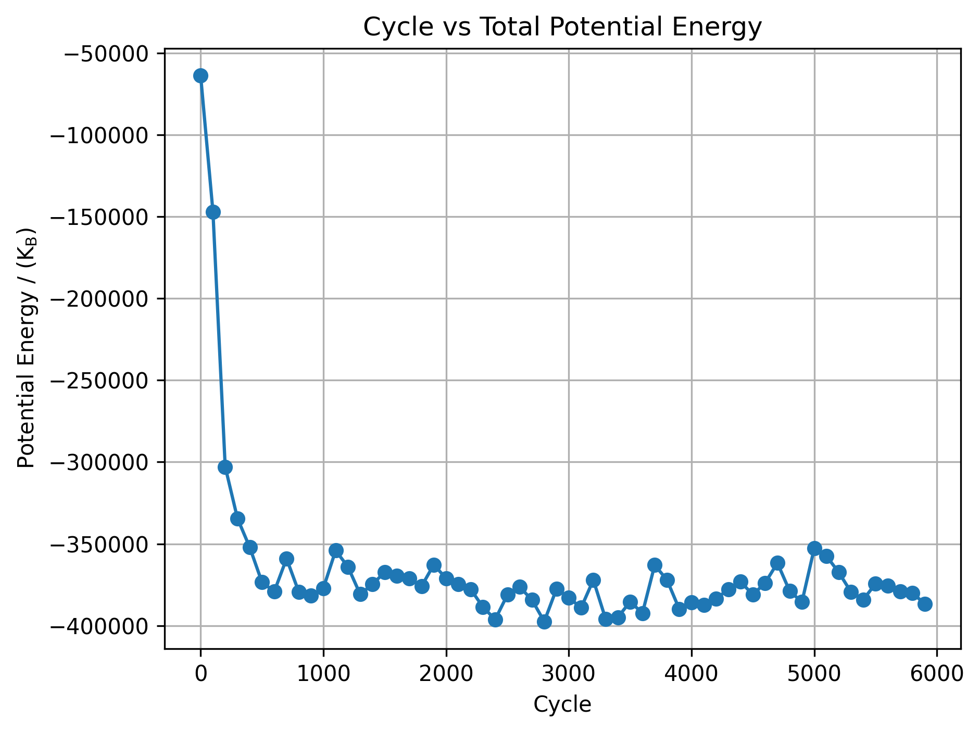
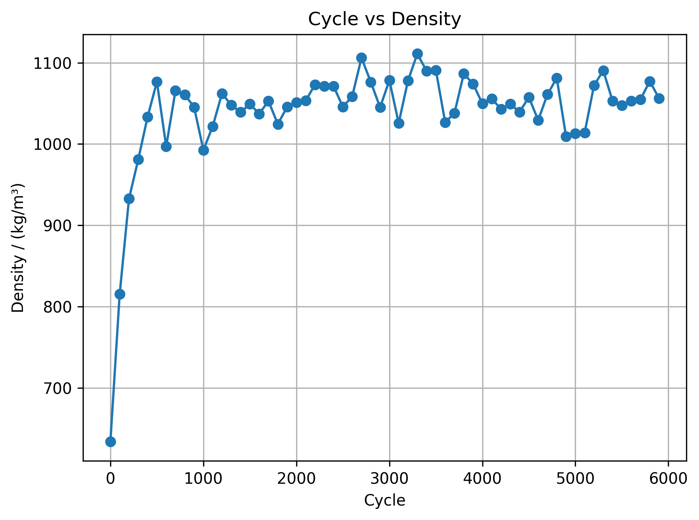
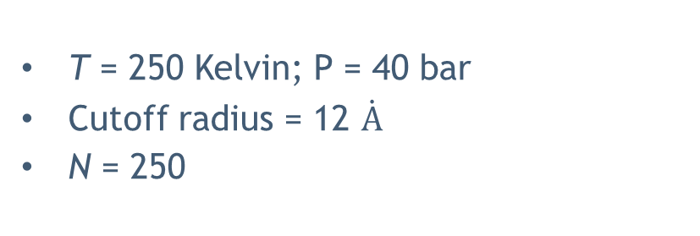
Exercise - 1
T = 250 Kelvin; P = 40 bar
Cutoff radius = 12 $\dot{A}$
N = 250
Production
Production
The chosen initialization and equilibration cycles were verified for all state points. The data used to generate the graphs above correspond to T = 250 K and P = 200 bar.
28

Slide 29
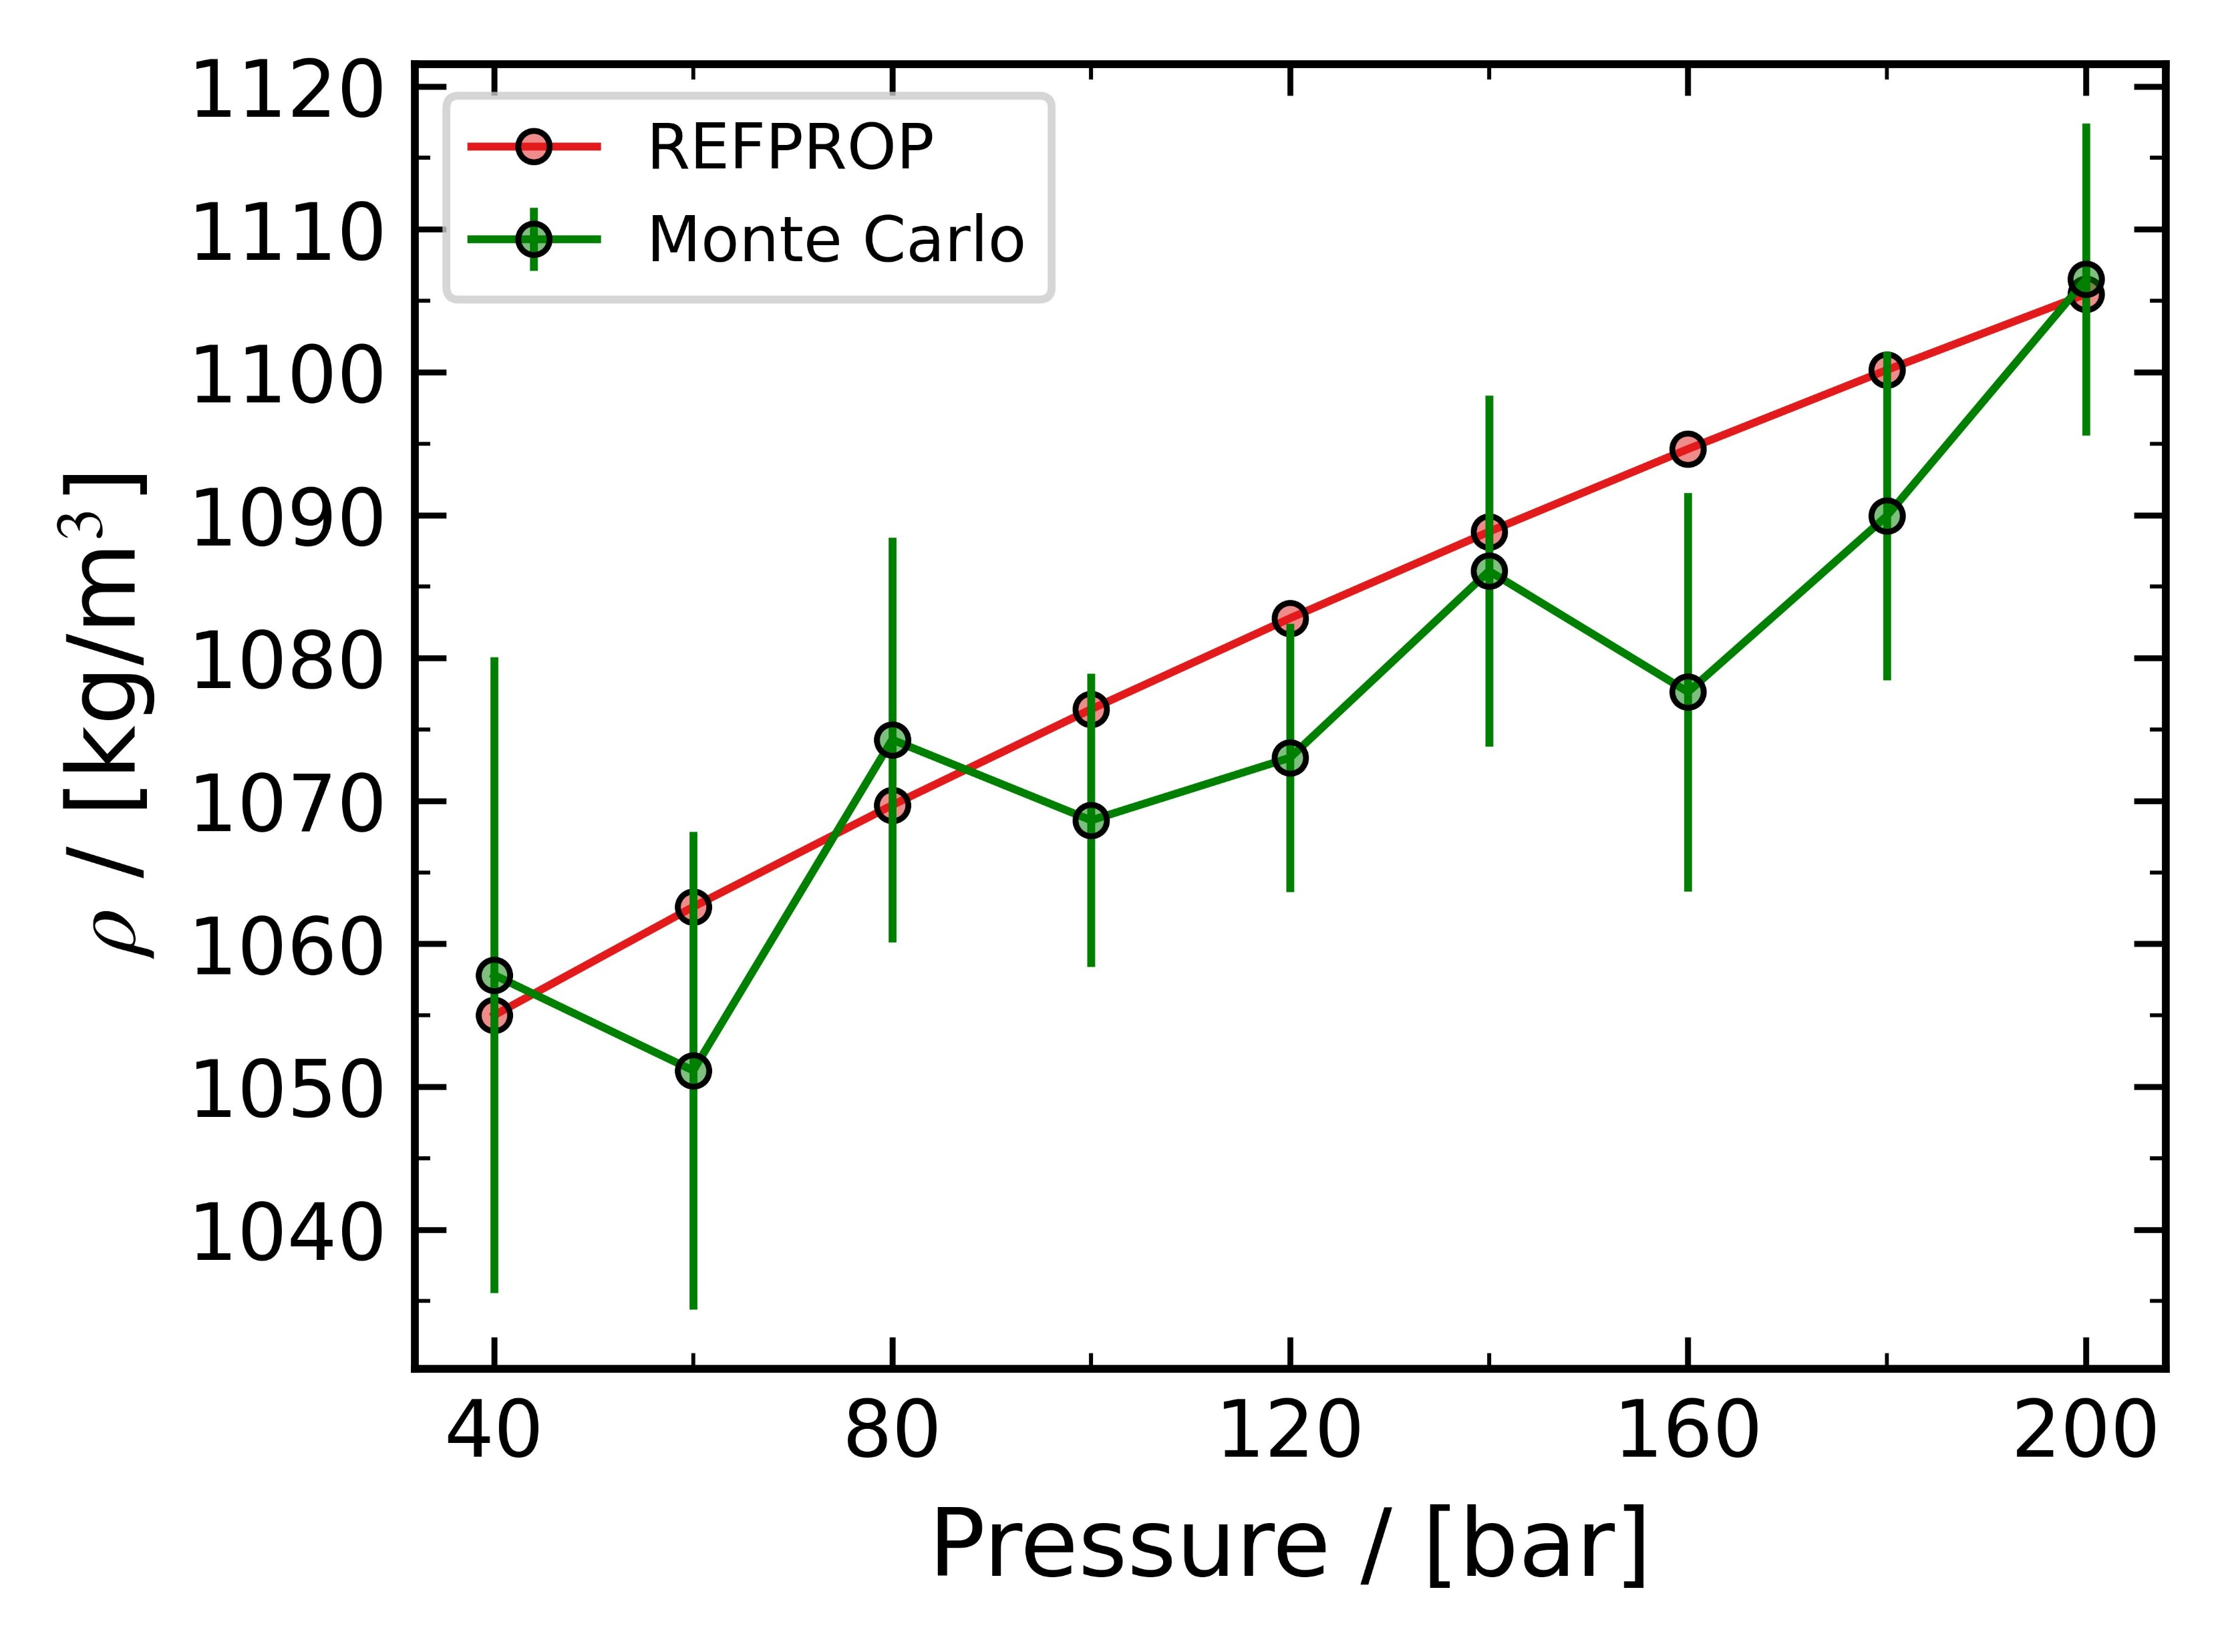
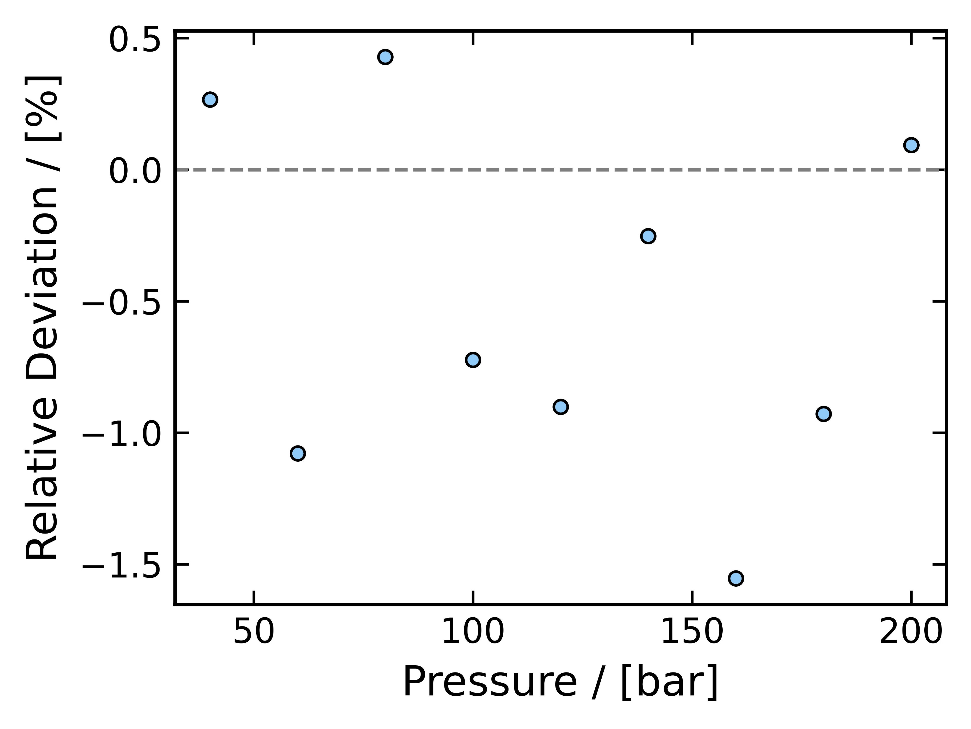
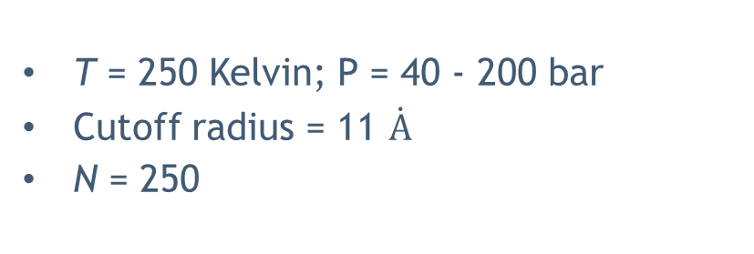
Exercise - 1
T = 250 Kelvin; P = 40 - 200 bar
Cutoff radius = 11 $\dot{A}$
N = 250
Simulation time = 6.2 to 6.3 mins
Density deviations compared to REFPROP were < 2 %
29

Slide 30
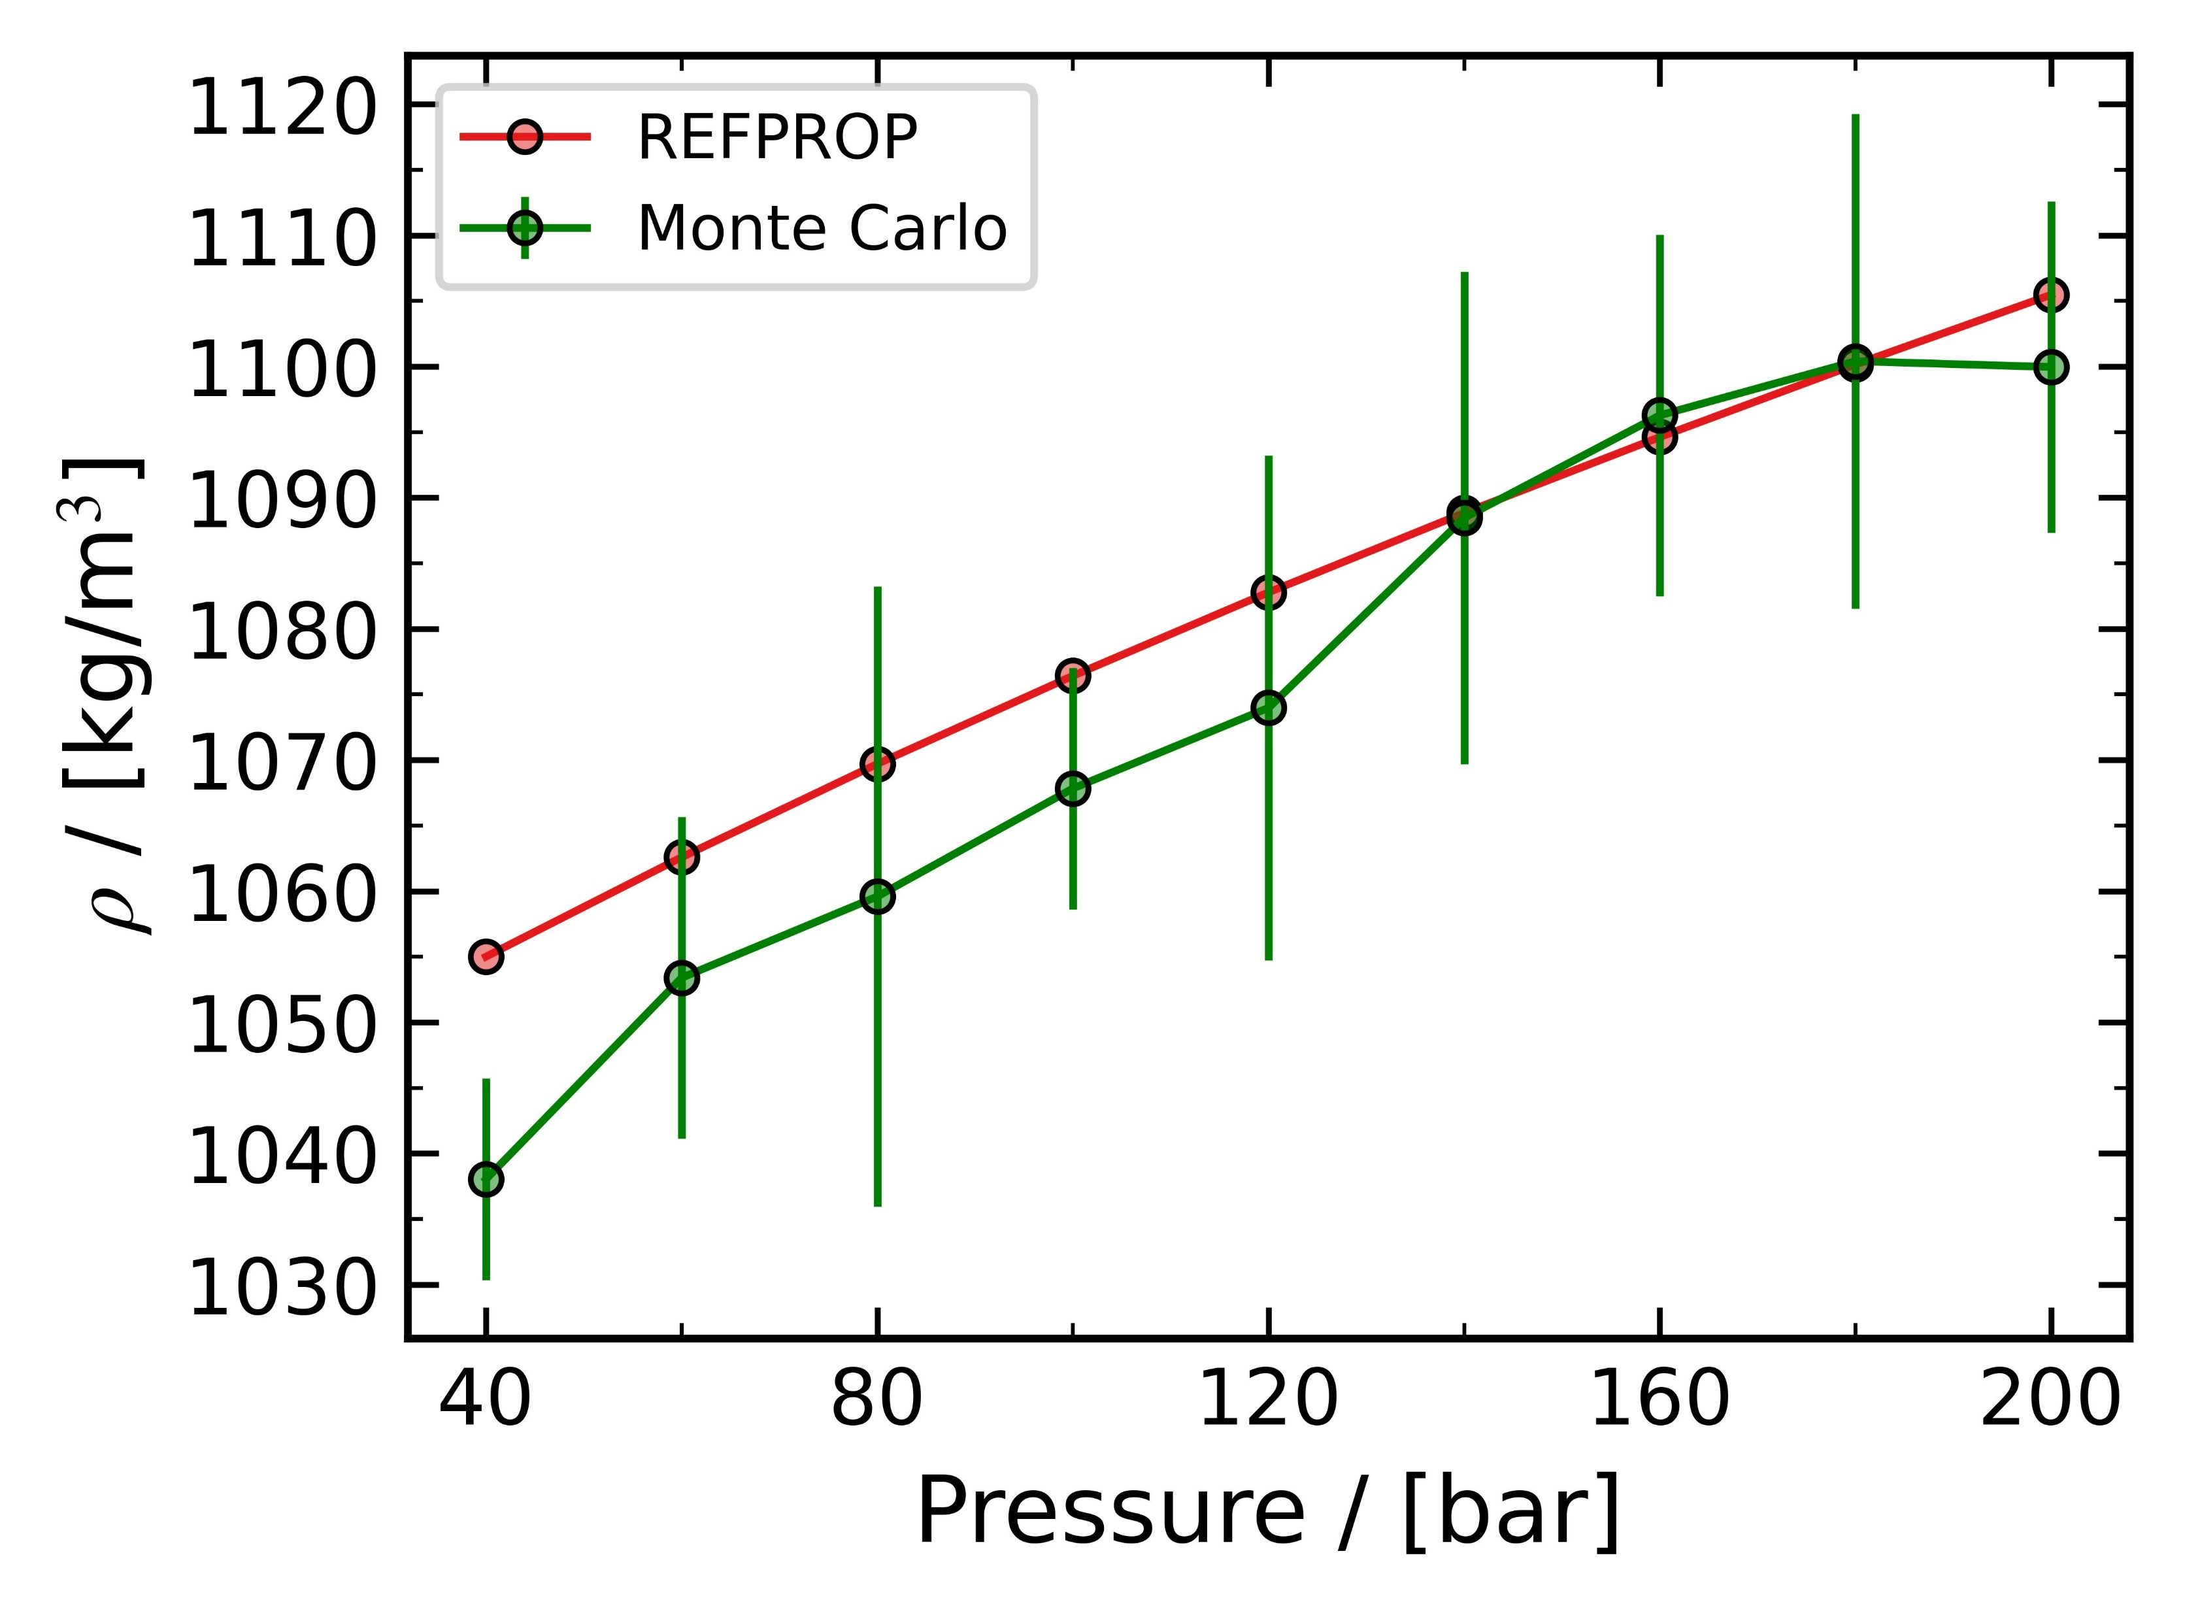
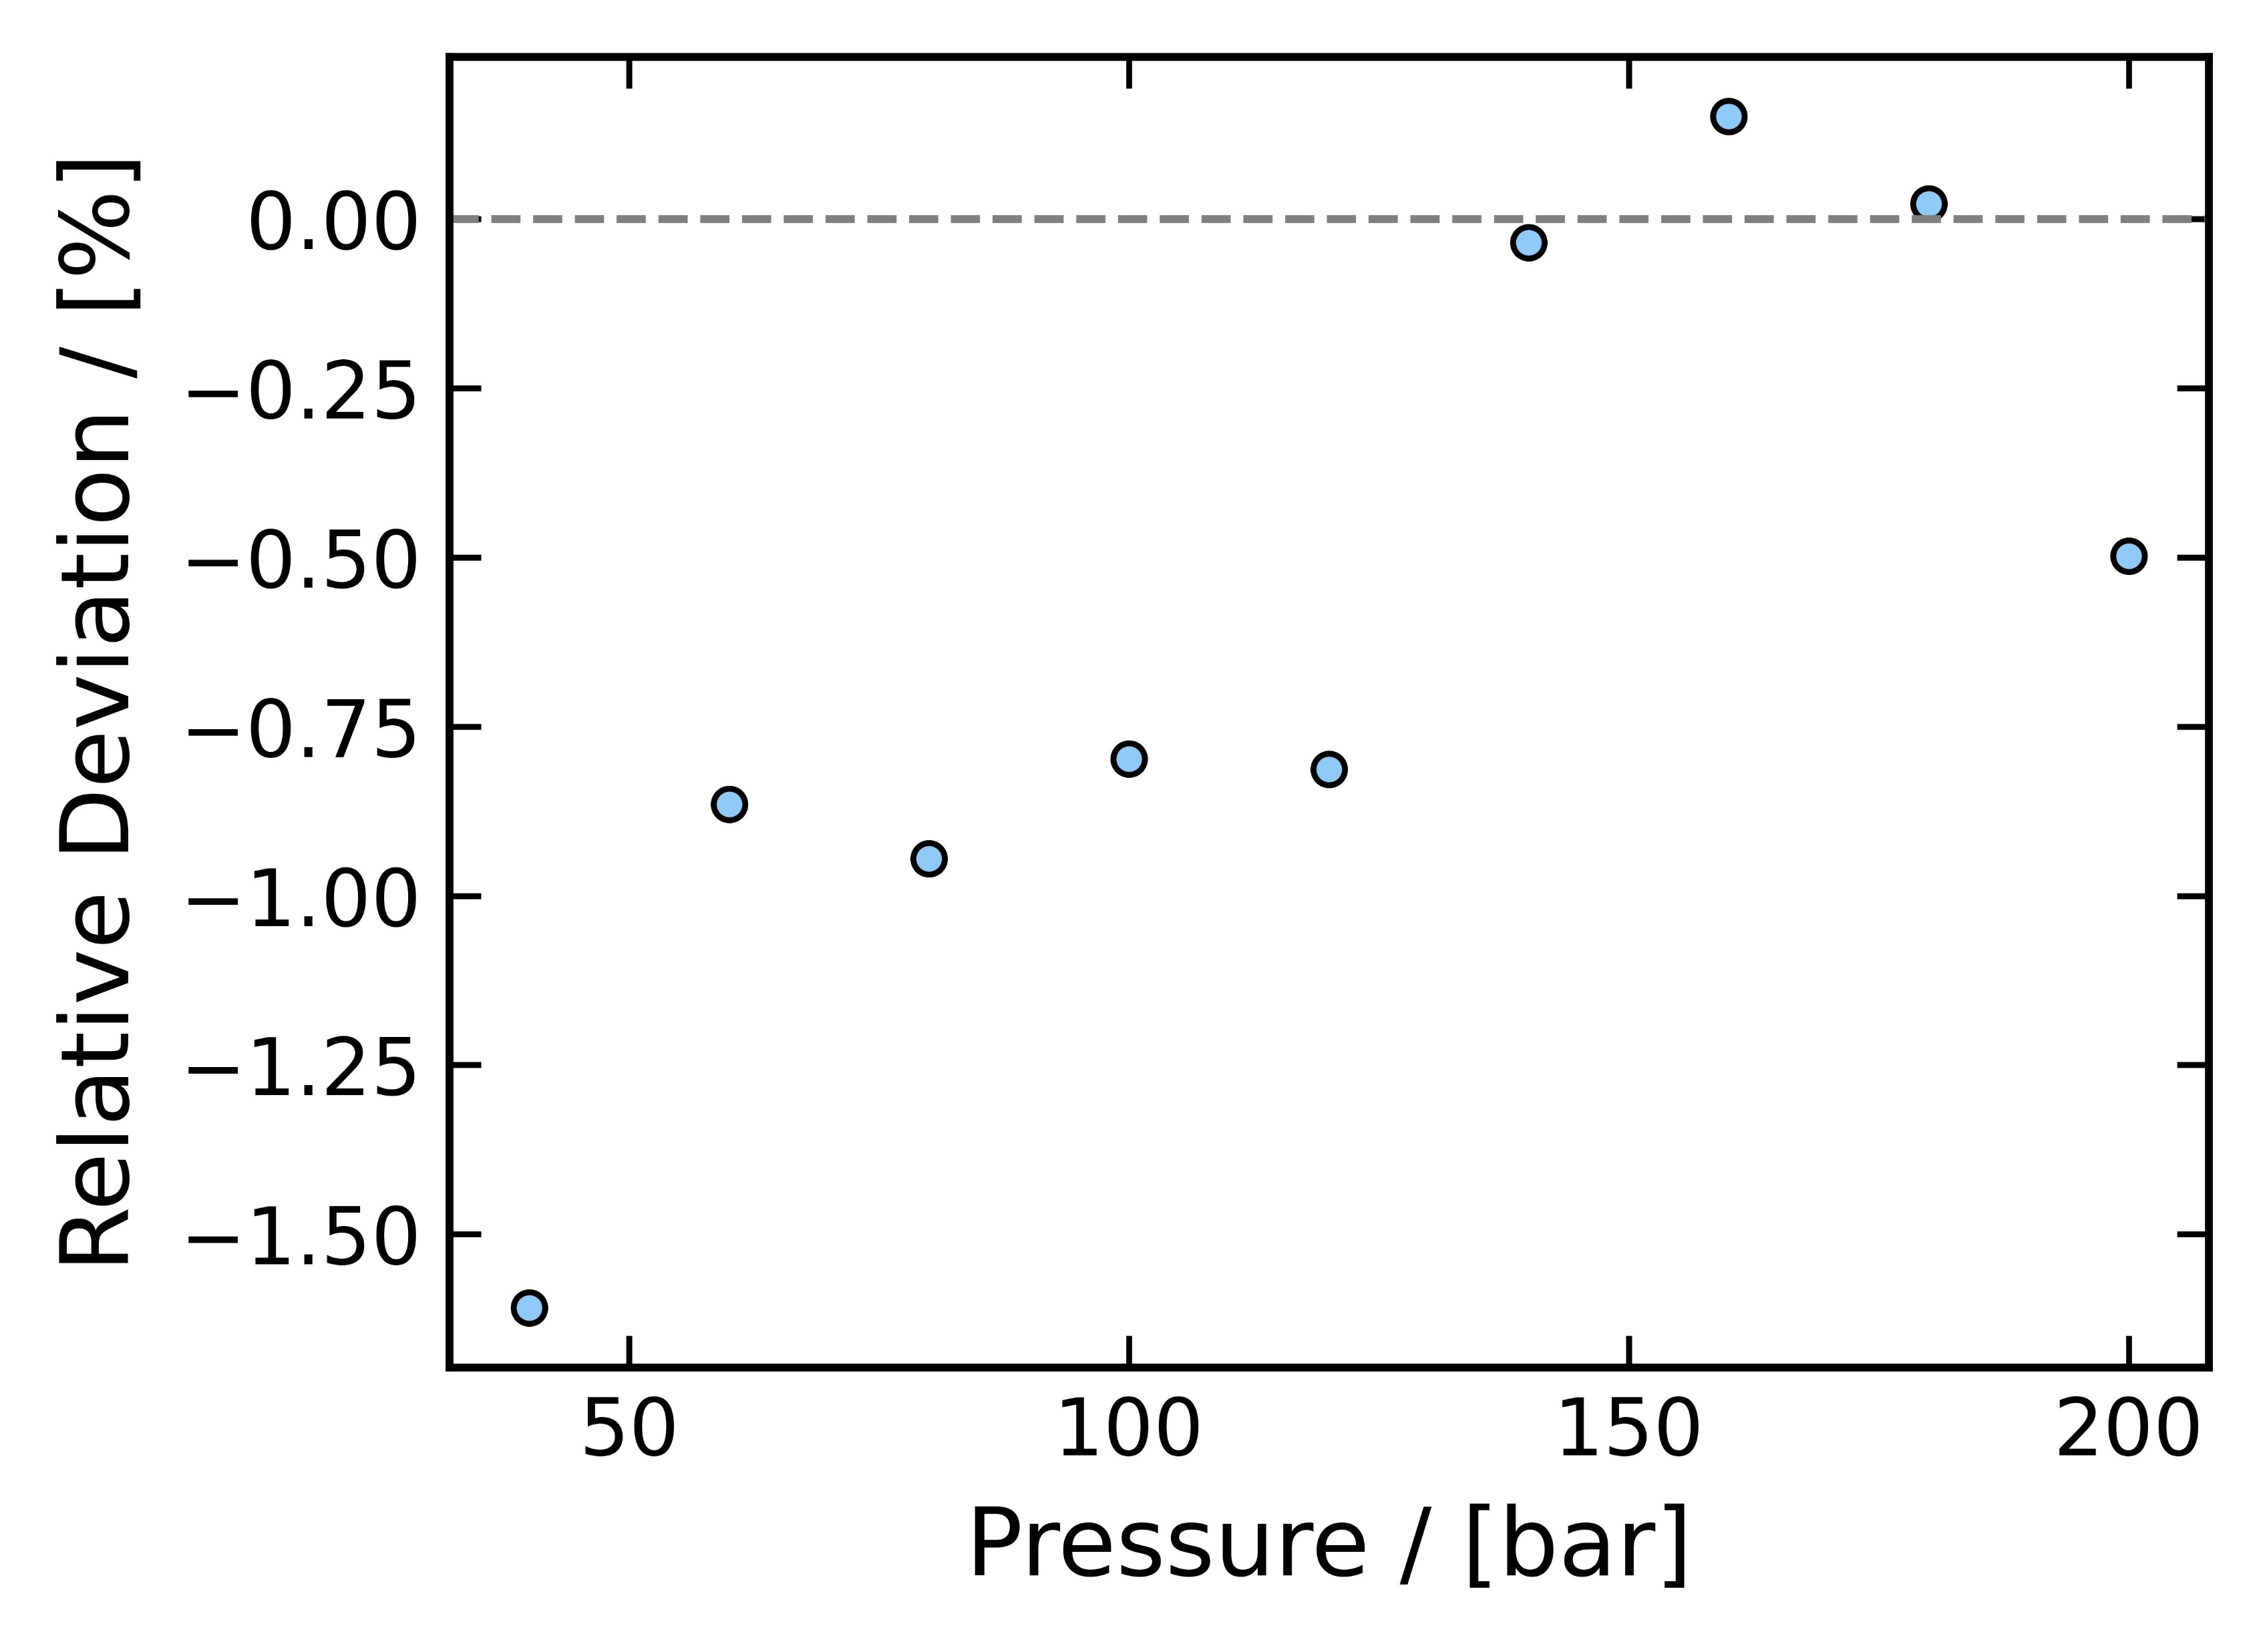

Exercise - 1
T = 250 Kelvin; P = 40 - 200 bar
Cutoff radius = 11 $\dot{A}$
N = 200
Simulation time = 4.6 to 4.8 mins
Density deviations compared to REFPROP were < 2 %
30

Slide 31
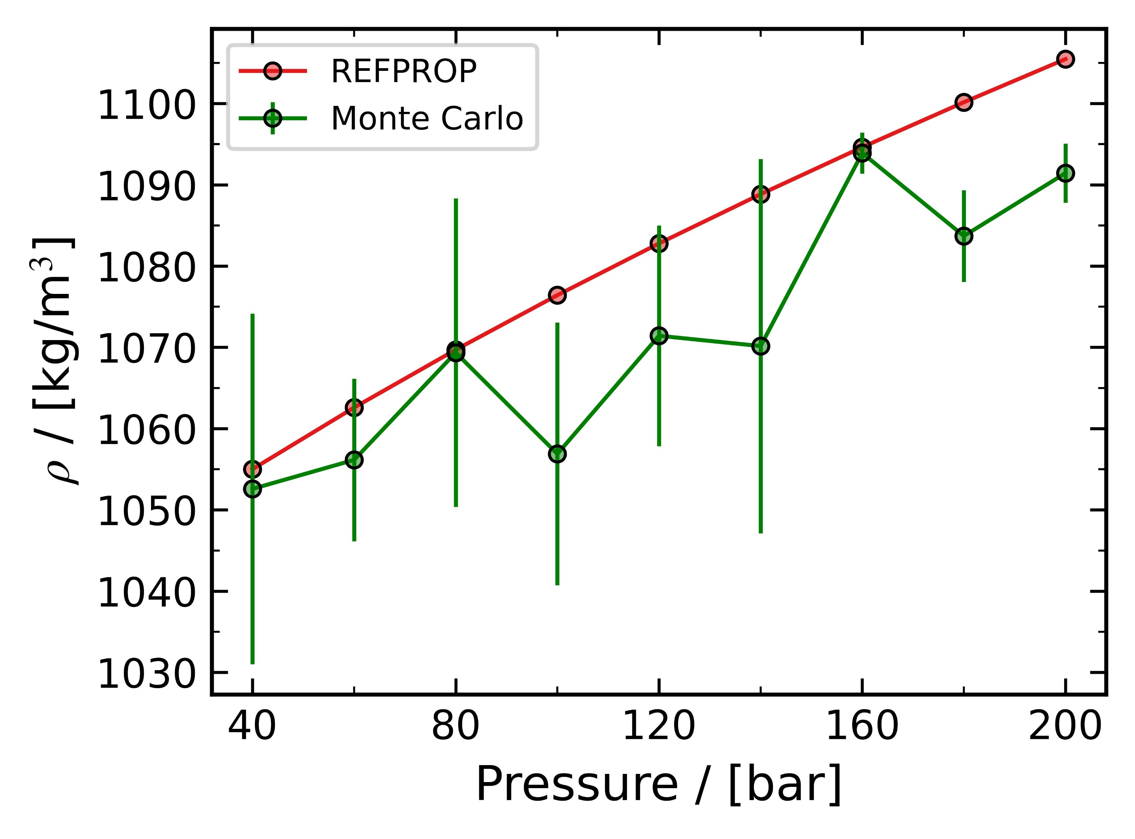
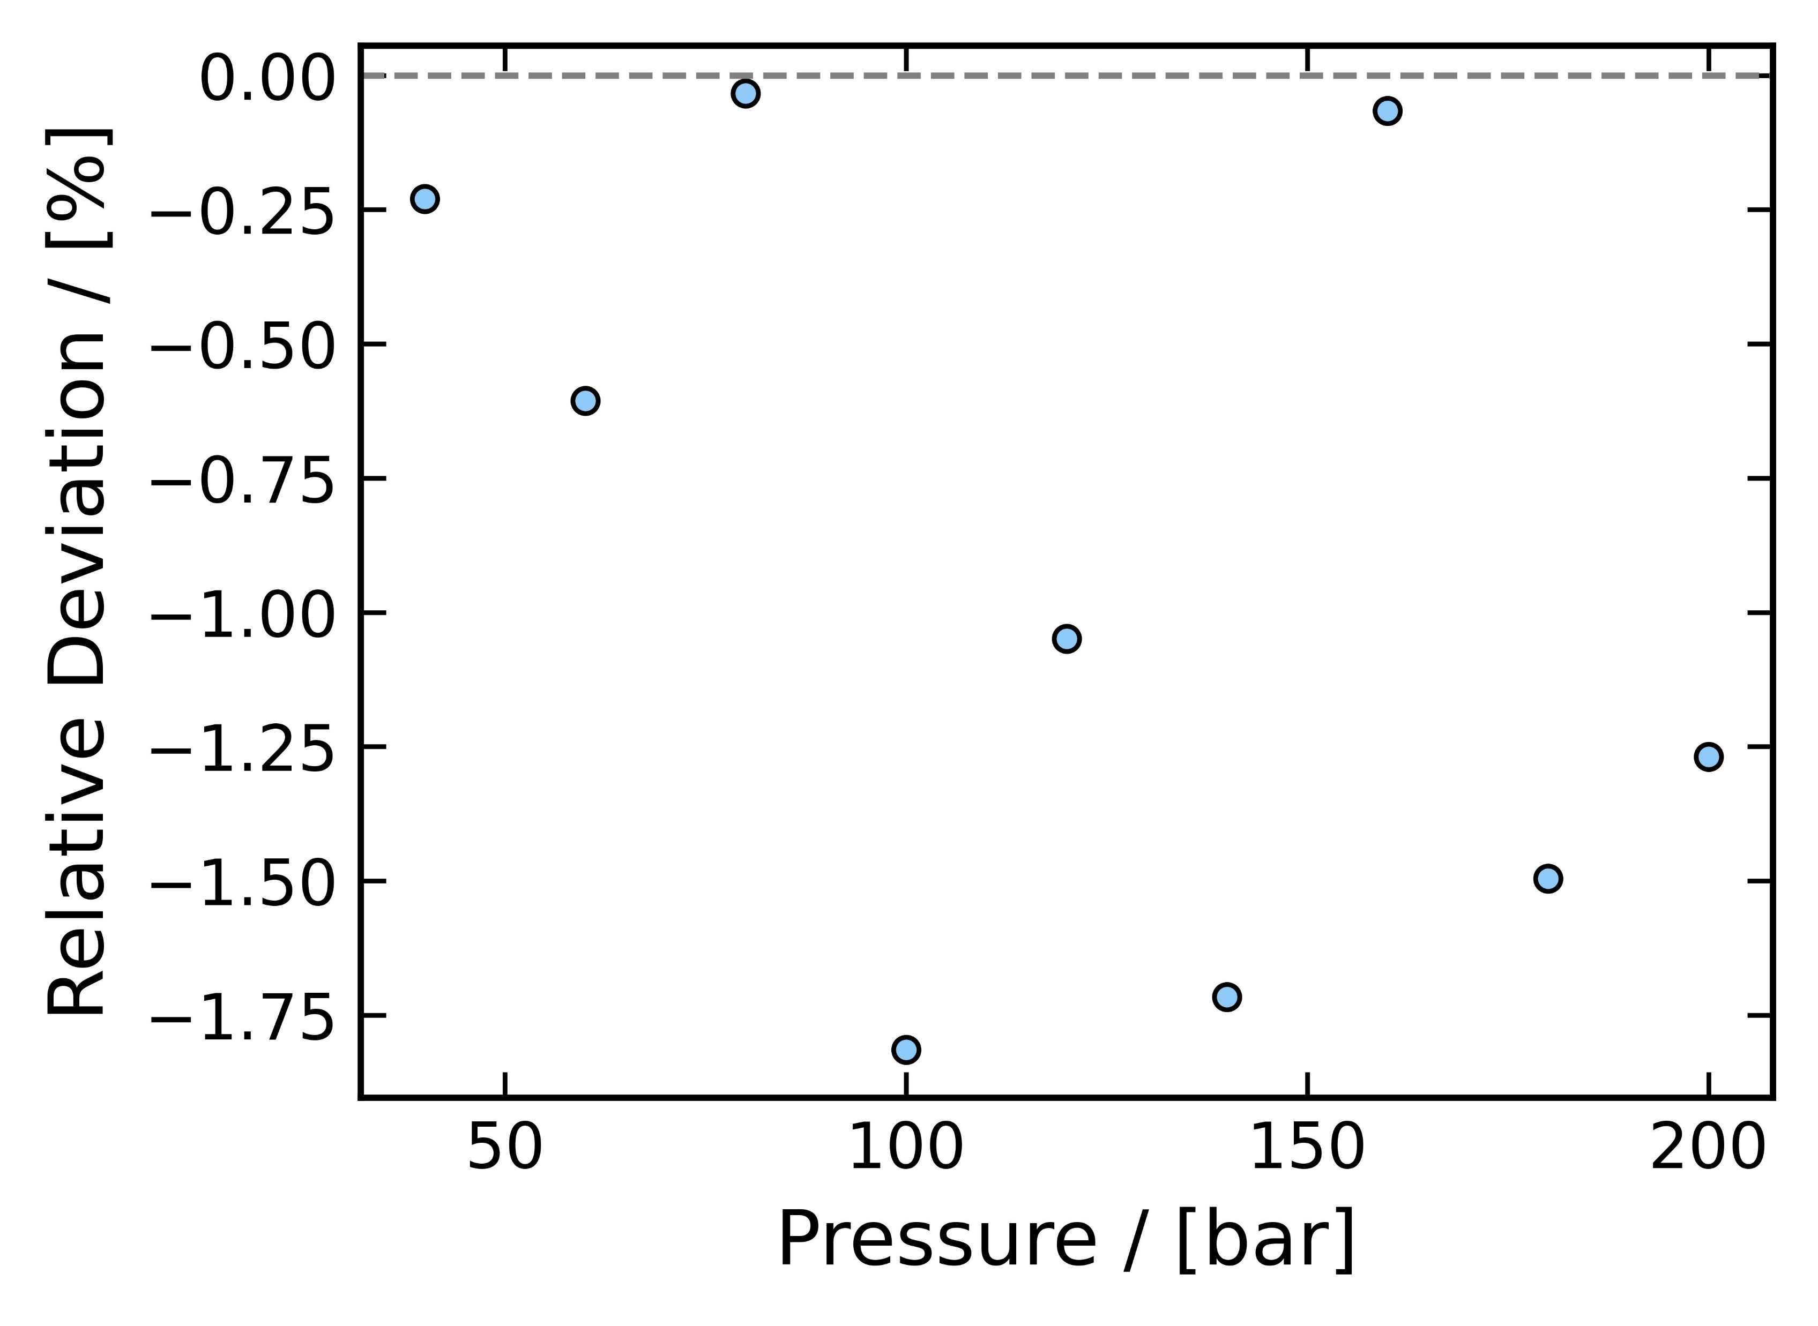

Exercise - 1
T = 250 Kelvin; P = 40 - 200 bar
Cutoff radius = 10 $\dot{A}$
N = 250
Simulation time = 5.6 to 5.8 mins
Density deviations compared to REFPROP were < 2 %
31

Slide 32
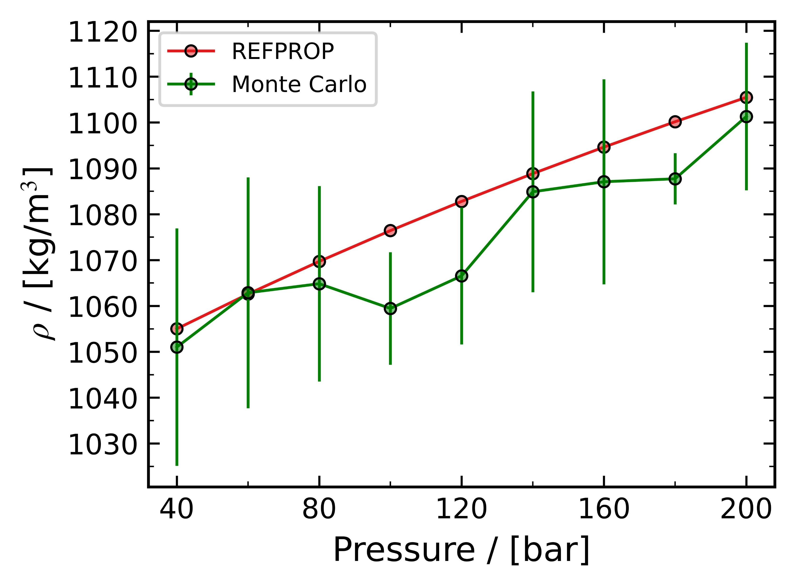
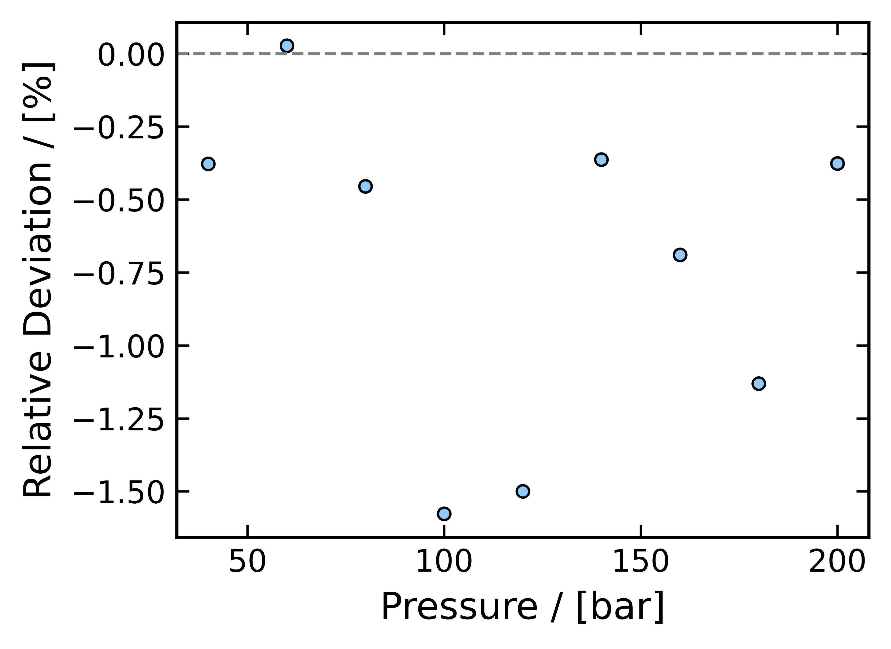

Exercise - 1
T = 250 Kelvin; P = 40 - 200 bar
Cutoff radius = 10 $\dot{A}$
N = 200
Simulation time = 4 to 4.1 mins
Density deviations compared to REFPROP were < 2 %
32

Slide 33
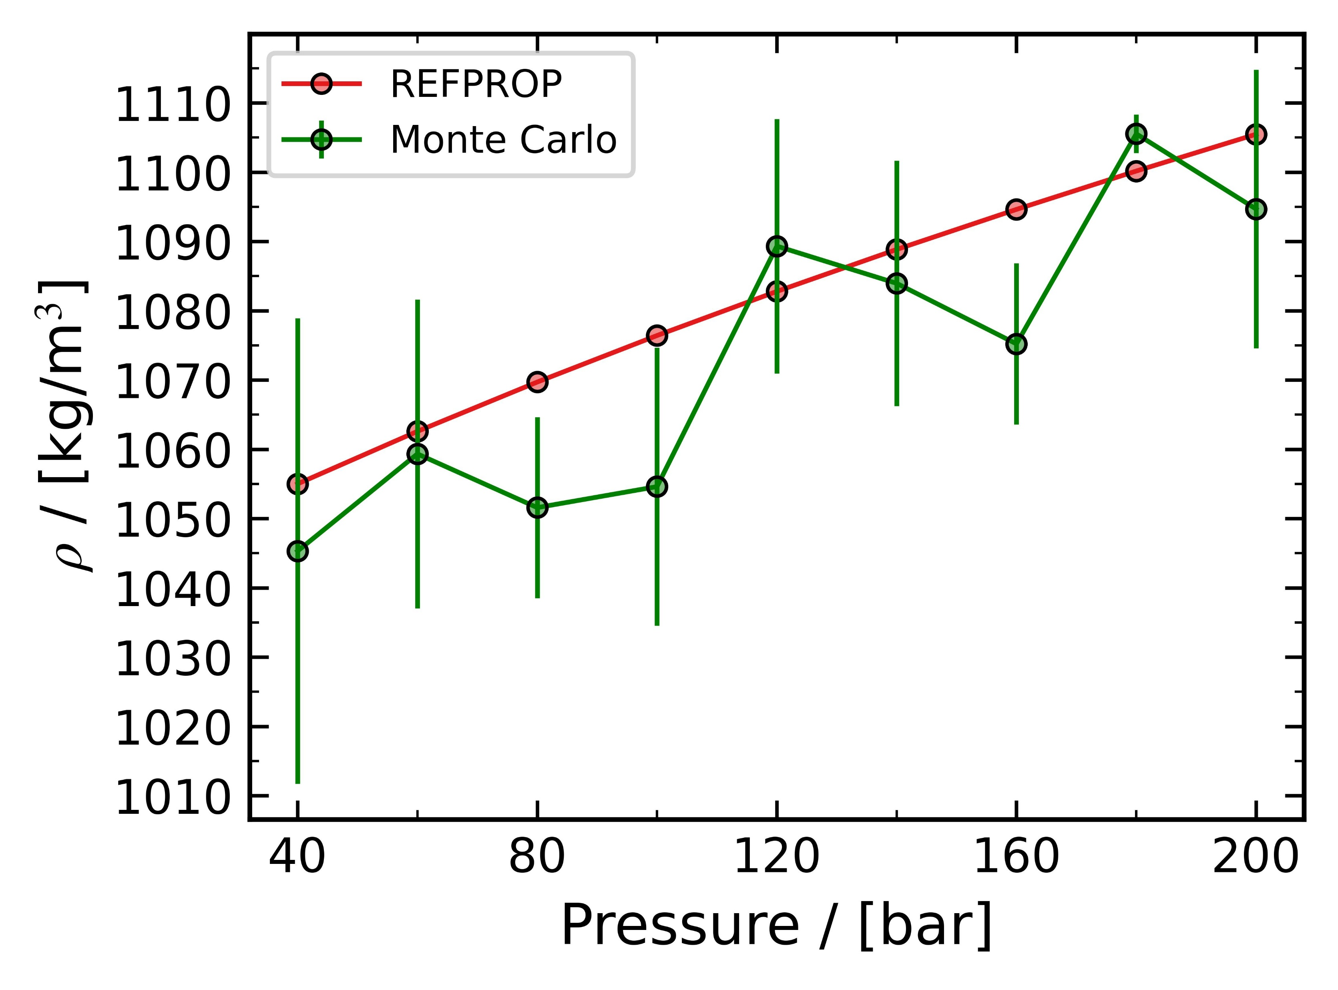
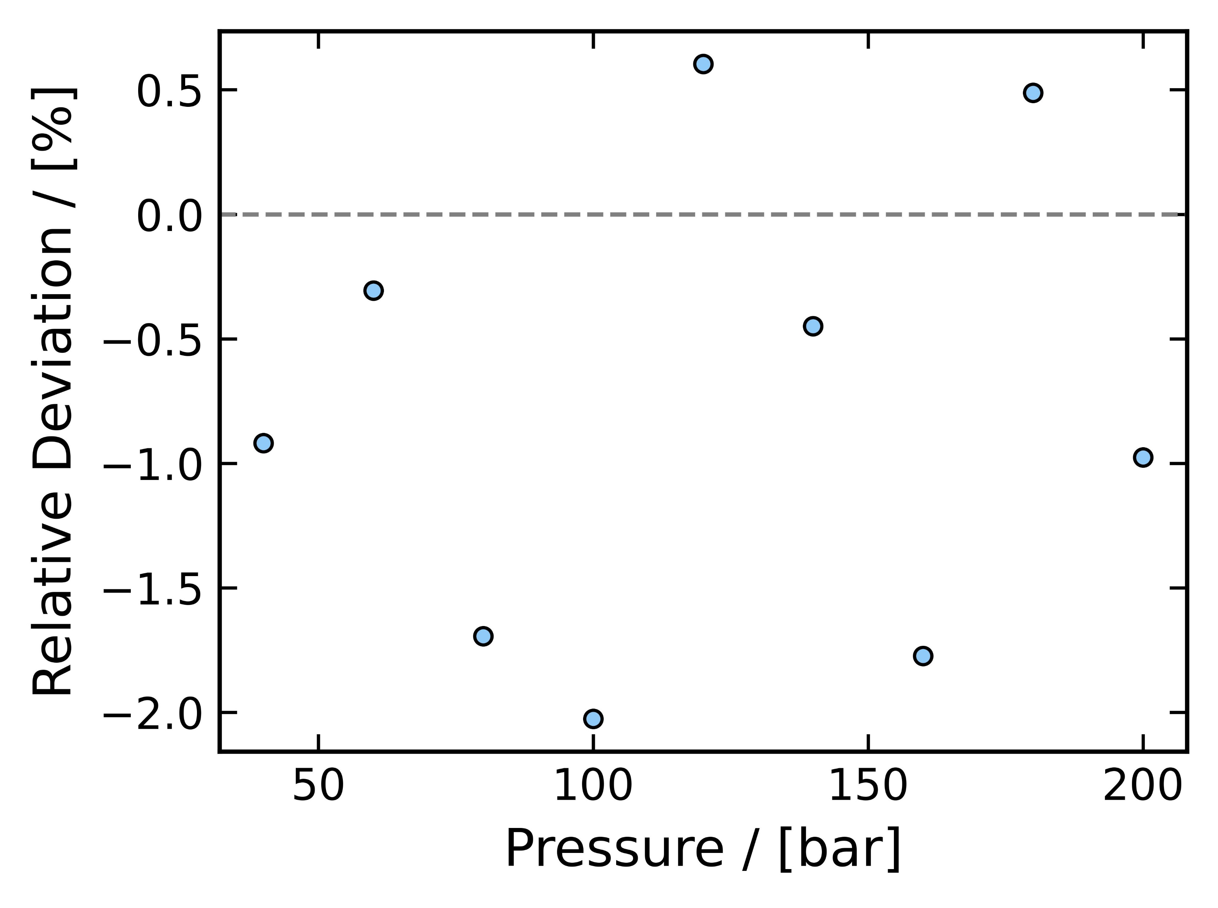

Exercise - 1
T = 250 Kelvin; P = 40 - 200 bar
Cutoff radius = 10 $\dot{A}$
N = 150
Simulation time = 2.7 to 3 mins
Density deviations compared to REFPROP were < 2.5 %
33

Slide 34
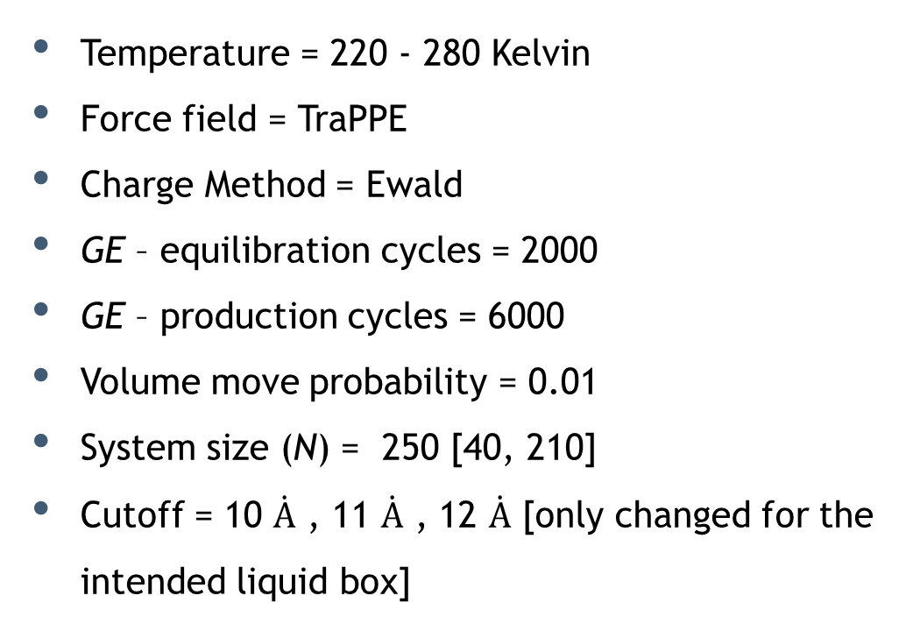
Exercise - 2
Vapor Liquid Equilibria (VLE) of CO₂
Temperature = 220 - 280 Kelvin
Force field = TraPPE
Charge Method = Ewald
GE – equilibration cycles = 2000
GE – production cycles = 6000
Volume move probability = 0.01
System size (N) = 250 [40, 210]
Cutoff = 10 $\dot{A}$ , 11 $\dot{A}$ , 12 $\dot{A}$ [only changed for the intended liquid box]
VLE of CO₂
The simulation time on my PC was recorded, and deviations from REFPROP results were analyzed
34

Slide 35
Exercise - 2
VLE computation of CO₂
T = 220 - 280 Kelvin
Cutoff radius = 10 $\dot{A}$
Cutoff radius = 11 $\dot{A}$
Cutoff radius = 12 $\dot{A}$
The system size N = 250 particles was kept constant for all the simulation. The simulation box 1 (N = 40) was intended to be vapor box and simulation box 2 (N = 210) was intended to be liquid box.
For the given cut off radius, the minimum number of particles was chosen such that the box length remained well above twice the cutoff radius.
35

Slide 36
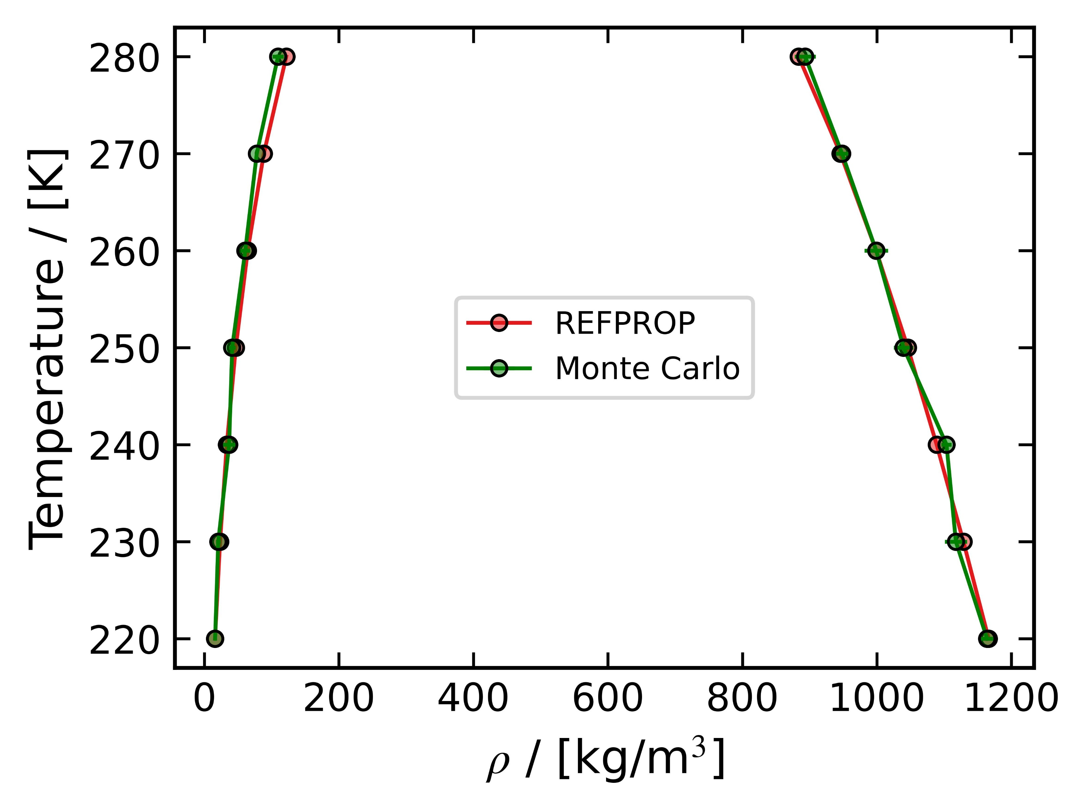
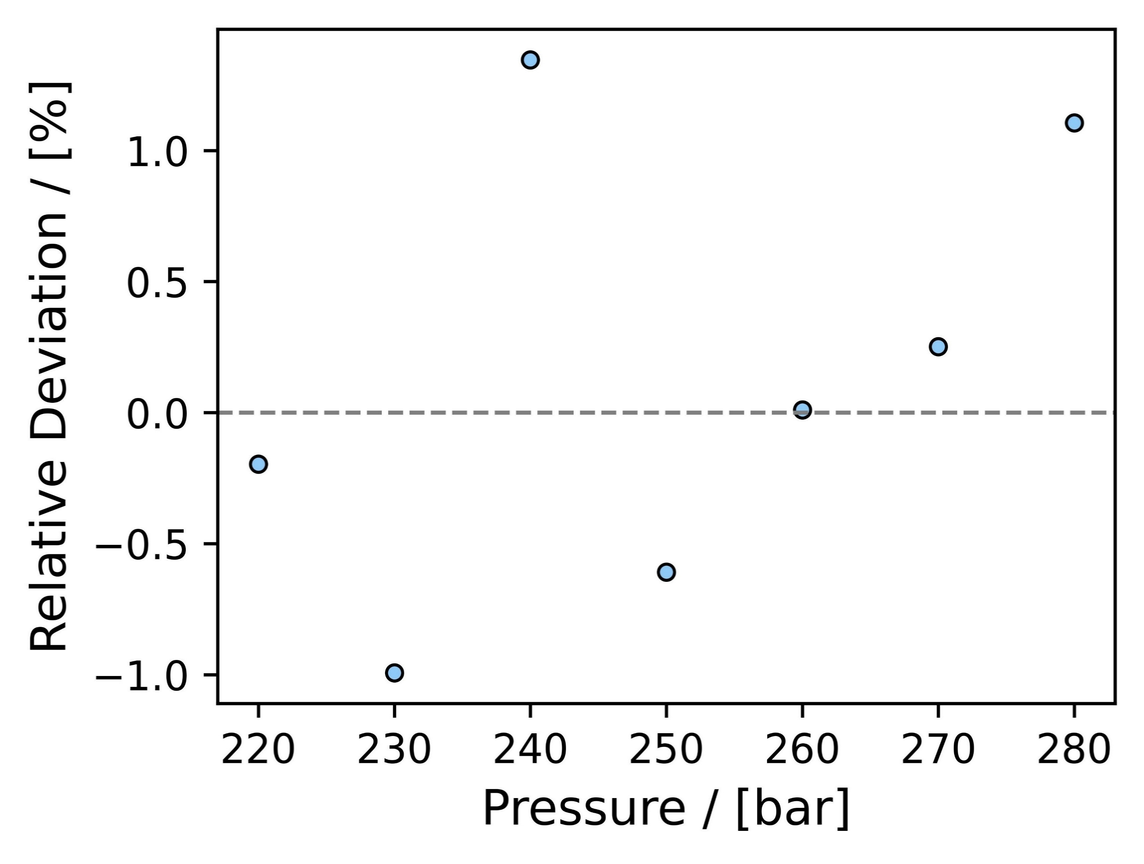
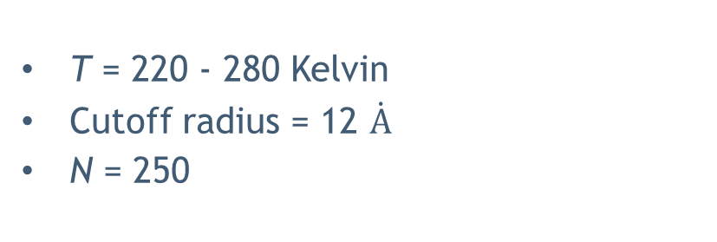
Exercise - 2
T = 220 - 280 Kelvin
Cutoff radius = 12 $\dot{A}$
N = 250
Simulation time = 9.2 – 9.5 mins
Only the liquid densities were considered to compute the relative deviation
Density deviations compared to REFPROP were < 1 %
36

Slide 37



Exercise - 2
T = 280 Kelvin
Cutoff radius = 12 $\dot{A}$
N = 250
Production
Production
The chosen initialization and equilibration cycles were verified for all state points. The data used to generate the graphs above correspond to T = 220 K.
37

Slide 38

Exercise - 2
T = 220 - 280 Kelvin
Cutoff radius = 12 $\dot{A}$
N = 250
Simulation time = 9.2 – 9.5 mins
Saturation pressure of CO₂ as a function of temperature
38

Slide 39



Exercise - 2
T = 220 - 280 Kelvin
Cutoff radius = 11 $\dot{A}$
N = 250
Simulation time = 9.0 – 9.1 mins
Only the liquid densities were considered to compute the relative deviation
Density deviations compared to REFPROP were < 1.5 %
39

Slide 40

Exercise - 2
T = 220 - 280 Kelvin
Cutoff radius = 11 $\dot{A}$
N = 250
Simulation time = 9.0 – 9.1 mins
Saturation pressure of CO₂ as a function of temperature
40

Slide 41



Exercise - 2
T = 220 - 280 Kelvin
Cutoff radius = 10 $\dot{A}$
N = 250
Simulation time = 8.2 – 8.4 mins
Only the liquid densities were considered to compute the relative deviation
Density deviations compared to REFPROP were < 1.5 % (except at 280 K where deviation of 3.5% was noticed)
41

Slide 42

Exercise - 2
T = 220 - 280 Kelvin
Cutoff radius = 10 $\dot{A}$
N = 250
Simulation time = 8.2 – 8.4 mins
Saturation pressure of CO₂ as a function of temperature
42

